Slide 1
Software Architecture and Design
Course Introduction

Slide 2
COURSE OVERVIEW
To study large systems and how they were partitioned into subsystems and components, as well as how the structuring of these elements into a solution and the interfaces used to join them together facilitates communication and control.
To explore with various notations and formalisms as they learn the relationship between these structures and key quality attributes and their impact on system implementation.
Differences between detailed design and architecture are explored, as well as notations used for both.
Several well-known architectural styles are analyzed .
The use of various notations is explored, with a focus on UML (Unified Modeling Language ), and the role of architecture and detailed design specifications are considered from the perspective of risk management.

Slide 3
LEARNING OUTCOMES. knowledge
The importance of taking a risk-based approach to software development.
Why doing so aids an organization in determining how much architecture is enough for a given project.
Students will be able to identify risks and discuss how to mitigate them.
How software architecture can be used to ensure quality goals will be met.
Be able to discuss the purpose for creating different views of software architecture and be able to contribute to discussions in determining which are appropriate for a given project.
To discuss architectural choices, the short-term and long-term consequences associated with each choice and the rationale for selecting one choice over the others.
Discuss architecture styles, as well as the advantages and disadvantages of their use.
Describe how software architecture and design can be used during software maintenance.
Students will also be able to identify system solution, from requirements to quality attributes and architectural structures to design patterns and detailed design, to implementation, testing, integration, sustainment and future reengineering as required to extend a system’s life.

Slide 4
skills
Use risk management processes, methods and techniques as the basis for deciding what to express and how best to express it, as well as what does not need documenting.
Draft detailed design documents consistent with a specified architecture for moderate to small systems using UML design notations.
To design module interfaces to support concurrent design and development by teams.
Develop draft architecture documents for moderate to small systems employing one or more views.
Use standard OO and other requirement notions to understand stakeholder requirements and express those.
Demonstrate understanding design intent required to implement modules, subsystems and systems.
Create views to capture and communicate key aspects of a design element for a specific and targeted audience
Use architectural styles and design patterns.
Use refactoring to improve code without changing its behavior.

Slide 5
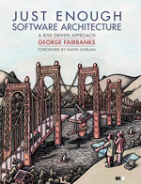
MATERIALS
Online Resources & References
In addition to the textbook, several websites contain required readings. See the course syllabus for more detail. Additional online resources and references may be added as needed.
Textbook
Just Enough Software Architecture:
A Risk-Driven Approach by George Fairbanks, Marshall & Brainerd Publishers.

Slide 6
Your Assignments
Project 01. Risk Assessment
Project 02. Initial Design
Project 03. Creating Models
Project 04. Patterns and Styles
Project 05. Using the Architecture
( Source: SDP05. Architecture and design)

Slide 7
Software Architecture and Design
Lecture 1. Introduction. Requirements Engineering.
Basics of Use Cases

Slide 8
What is software (SW)?
SW is
not only programs
but also all associated documentation, and
configuration data
that make these programs operate correctly.
More specifically, a SW system consists of
separate programs
configuration files setting up these programs
system documentation describing the structure of the system in good detail
user documentation explaining how to use and operate the system.

Slide 9
What is SW Engineering (SWE)?
SW engineering is an engineering discipline
concerned with all aspects of SW production starting from the early stages of system specification through to the maintenance of the system after it has started to be used.
engineering discipline:
implies solving a well-defined (or in SW engineering vaguely defined) problem optimally using resources (e.g., time, man power and machine power) and remaining within
organizational (i.e., the customer)
financial, and
other possible
constraints.
all aspects of SW production:
encompasses
not only the technical processes
but also deals with project management, development of tools, methods and theories to support SW production.

Slide 10
Software engineering is important for two reasons:
1. More and more, individuals and society rely on advanced software systems. We need to be able to produce reliable and trustworthy systems economically and quickly.
2. It is usually cheaper, in the long run, to use software engineering methods and techniques for professional software systems rather than just write programs as a personal programming project. Failure to use software engineering method leads to higher costs for testing, quality assurance, and long-term maintenance

Slide 11
What is a SW process?
Four fundamental activities and associated results which produce a SW product.
SW (requirements) specification
SW development ...
Design phase
Implementation phase
SW verification and validation (SW V&V)
SW evolution

Slide 12
SW (requirements) specification. Requirements Engineering (RE)
The requirements for a system are the descriptions of the services that a system should provide and the constraints on its operation.
The process of finding out, analyzing, documenting and checking these services and constraints is called requirements engineering (RE).
Basically, it’s the process of determining and establishing the precise expectations of the customer about the proposed software system.
Aim to develop system to meet user needs
Capture user requirements through:
Background reading/research
Interviews with users/clients
Observation of current practices
Sampling of documents
Questionnaires

Slide 13
User and system requirements
User requirements to mean the high-level abstract requirements and system requirements to mean the detailed description of what the system should do.
User requirements and system requirements may be defined as follows:
1. User requirements are statements, in a natural language plus diagrams, of what services the system is expected to provide to system users and the constraints under which it must operate.
2. System requirements are more detailed descriptions of the software system’s functions, services, and operational constraints. The system requirements document (sometimes called a functional specification) should define exactly what is to be implemented. It may be part of the contract between the system buyer and the software developers.

Slide 14
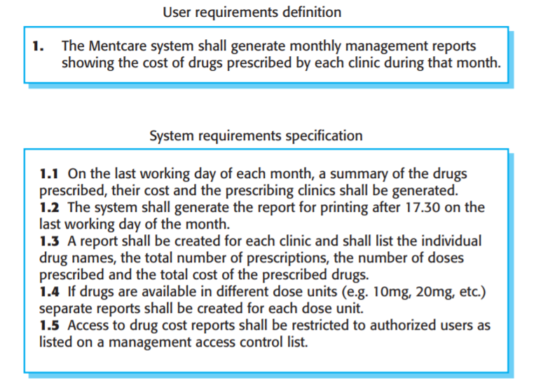
User and system requirements
Source: Ian Sommerville (Software Engineering 10th Edition, 2016

Slide 15
Functional and non-functional requirements
Functional: The precise tasks or functions the system is to perform.
e.g., details of a flight reservation system
Non-functional: Usually, a constraint of some kind on the system or its construction
e.g., expected performance and memory requirements, process model used, implementation language and platform, compatibility with other tools, deadlines, ...

Slide 16
Basics of Use Cases
Use case diagrams are part of the Unified Modeling Language.
Use cases concisely describe required functionality including quality related information.
What system does, not how
Focus on functionality from users’ perspective
not appropriate for non-functional requirements
Use cases help developers clarify requirements because they provide view of the system from perspective of users – not software developers – so provide a kind of bridge between the customer and the developers.
Use Cases are great for stimulating discussions about what the customer really wants the system to do and often reveal new information about how the customer really wants it to behave.
Use case diagrams are a pictorial representation of a collection of tasks the system should perform and who uses them.
A “complete” use case diagram would include all tasks, but that is usually not possible and generally unnecessary.
When identifying use cases, focus on tasks that seem important, will be used a lot, or appear to involve complex interactions.

Slide 17
Use case Notation
Use case diagrams depict:
Actors: people or other systems interacting with system being modelled. Actors are drawn as stick figures.
Use cases: represent sequences of actions carried out by the system.
Communication(Association): between actors and use cases are indicated in use case diagrams by solid lines.
System boundary boxes (optional). You can draw a rectangle around the use cases, called the system boundary box, to indicates the scope of your system.
Withdraw
Cash
Notes:
Use case diagrams show:
Actors: people or other systems interacting with system being modelled. Actors are drawn as stick figures.
Use cases: represent sequences of actions carried out by the system.
Communication(Association): between actors and use cases are indicated in use case diagrams by solid lines.
System boundary boxes (optional). You can draw a rectangle around the use cases, called the system boundary box, to indicates the scope of your system.

Slide 18
UML Use Case Diagram
Communication
association
Withdraw
Cash
(Sub)system
boundary
Check
Balance
CardHolder
Actor
Use case
( Source: SDP05. Architecture and design)
Notes:
Use Case Diagram looks like this

Slide 19
Simple Use Case Description
ATM system example:
Withdraw Cash:
The card holder selects the withdraw cash menu, which is displayed by the system. The card holder selects an amount of cash. The system debits the user’s account, returns the user’s card and issues the requested money.
( Source: SDP05. Architecture and design)

Slide 20
Elaborated Use-Case Description
Actor
System
1 | User selects cash withdrawal option | System displays cash withdrawal menu
2 | User selects cash amount | System checks cash is available; returns card
3 | User takes card | System dispenses cash
4 | User takes cash | System returns to start menu

Slide 21
Use case Scenarios
Use case represents a generic case of interaction
A particular course that a use-case instance might take is called as scenario
For example, there may be many Withdraw Cash scenarios where no cash is withdrawn!
Card holder has insufficient funds on account
ATM cannot connect to bank’s system
ATM does not contain enough cash
Customer cancels the transaction for some reason
Notes:
Use case represents a generic case of interaction
A particular course that a use-case instance might take is called as scenario
For example, there may be many Withdraw Cash scenarios where no cash is withdrawn!
Card holder has insufficient funds on account
ATM cannot connect to bank’s system
ATM does not contain enough cash
Customer cancels the transaction for some reason

Slide 22
Example Scenarios
CardHolder Mary Jones selects the cash withdrawal menu. She changes her mind, cancels the transaction and takes her card
CardHolder Peter Smith selects the cash withdrawal menu. He selects a cash amount, but is refused because he has insufficient funds on his account. His card is returned

Slide 23
Types of Relationship on Use case Diagram
Generalizes:
Permits actors/use cases to inherit properties of more general actors/use cases
Include:
Permits use case to include functionality of another use case
Extend:
Allows for optional extensions of use case functionality

Slide 24
Generalizes Relationship example
BankMember specializes CardHolder
Withdraw
Cash
CardHolder
Check
Balance
Generalizes
Relation
Order Statement
BankMember

Slide 25
Include Relationship example
Select Account is included in each of the use cases
Withdraw
Cash
«include»
Check
Balance
«include»
Select Account
BankMember
Order Statement
«include»
Note: include was formerly called uses

Slide 26
Extend Relationship example
CardHolder has the option of printing out a balance when the Check Balance use case is invoked.
Print Balance
«extend»
Check
Balance
Extend relationship
CardHolder

Slide 27
Summary
Use case analysis often a first step in system development:
provide high-level view of system functionality (what rather than how) and its users
Model generic activities
Particular instances of use-cases are termed scenarios
UML use case diagrams
Contain actors, use cases and associations
supported by behaviour specifications (e.g. use-case descriptions)

Slide 28
Thank you for the attention!

