Slide 1
2-модуль. Пайдаланушыға арналған дизайн және өзара әрекеттесу взаимодействие
CSE 5442 Адам-компьютер өзара әрекеттестігі
5-дәріс. Пайдаланушыға арналған дизайнның қағидаттары
Лектор: ф.-м.ғ.к., ассоц. профессор
Ягалиева Багдат Есеновна

Slide 2
Пайдаланушыға бағытталған дизайн қағидаттары
Дизайнның формалды элементтері
Алдын ала дизайн
Жобаның қысқаша сипаттамасы (мазмұн, контекст, аудитория):
Бұл не?
Кімге арналған?
Бұл қайда орналасқан?
Қандай шектеулер бар?
Мысал 1: гитараға (домбыраға) арналған тюнер)
  Телефонға арналған қолданба, ол гитараны (домбыраны) күйге келтіруге көмектеседі.
  Мақсатты аудитория — бастаушы гитаристер (домбырашылар).
  Көрінбейтін дизайн (алдын ала дизайн) — яғни интерфейссіз, пайдаланушының есту және сезіну қабілетіне сүйенетін дизайн түрі.
Мысал 2: Ғылымға әуес жандарға арналған цифрлық микроскоп қосымшасы
Бұл — цифрлық микроскопты басқаруға арналған қосымша,
ол техникалық нәрселерді жасауды қалайтын әуесқой ғалымдарға арналған
Клиент анықтайды → шектеулер мен мақсаттарды ← түсінеді ← Дизайнер
Дизайн бойынша дағдылар мен білім → ЖАҚСЫ ДИЗАЙНЕР ← Сала бойынша сарапшы
Notes:
Most design projects have a brief, and a brief outlines or describes the project before you even begin designing. The brief itself is kind of a design project in its own way. So, it's interesting to look at this idea of, "what's in a brief?" A brief often describes what the project is, what its goals are, and how it's going to work. So, this involves looking at content, context, and audience. We need to define...
What is it?
Who is it for?
Where does it live?
Without this clear articulation of these goals, you could be making something for weeks or months without it really achieving what you wanted to achieve. So, let's look at how these three questions might work in a brief and let's look at some examples.
For instance, if we thought about what is it, let's come up with an idea. Perhaps we want to make a dombra tuner, that's something that could be quite interesting to exist on a digital platform. We can also think about who is it for, let's say that it's for beginning dombrists. It's not for master dombrists that might already know how to tune their dombra. It's really for novices - people that are just starting out and might need some help. We could also think about, where does it live? It would be logical for this to live on a phone app, so that it could be possible, it could be easy to carry around and something that we could use hands-free when we’re tuning our dombra. So, when you put these things together, you've got an accurate description, it's a phone app to tune your dombra for beginning dombrists. This is entirely non-visual but we've already started to give some shape to our idea. We've already started to describe it with words and this is pre-design. It's really design that outlines or defines what the project is before you've even made anything.
So, let's try it again. But let's think of a different subject this time. How about an app for students who need chocolate bars or crisps for late-night study breaks. This app will allow you to find a specific food within a given area. It will be the main goal.
Now let’s think about other subject. How about a digital microscope? That sounds like something that could be quite interesting to make as an app and that could utilize a lot of what a phone can do. So, who is it for? In this case, it's going to be for amateur scientists. So again, it's not for the novice but it's also not for the expert. A proven scientist might need something much more technical. Where would it live? It would seem again that this would work as a phone app best of all so it can utilize what a phone is good at. It could use the camera in the phone and it could use the screen of the phone to look at what you're magnifying. If we put these things together, we'd have an accurate description of what the project is, who it's for and where it's going to live? A digital microscope for amateur scientists on your phone. Again, it's purely non-visual. It really just describes the project using words. We've articulated what it is so when we start to make something, we've got a clear set of goals. This is really important to know that our goals, constraints, platform, audience, all of these things are going to shape and inform the design and quite often the designer doesn't get to decide these things. These things are determined by the client. Often, they're determined by the client in the brief, before the designer even gets a chance to think about them or work with them.
So, if you want to be a good designer you're going to need what the goals are? What the constraints are? What kind of platform your project is going to live on? Who the audience is? Because these things will inform your design. What this means is, you really need to know your project, you need to understand every aspect of it so you can make the best possible visual solution for it. More than anything, you need to be the expert no matter what kind of content you're going to be working with. You should be the expert as a designer, but also be the expert in terms of the content that you're working with.

Slide 3
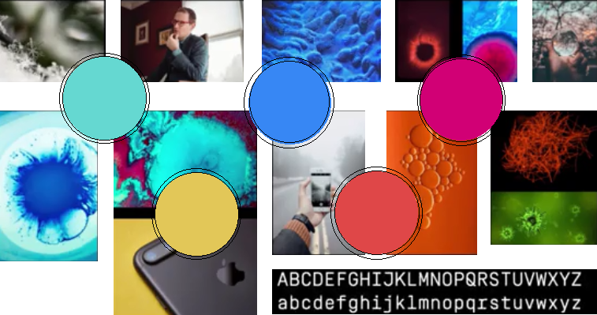
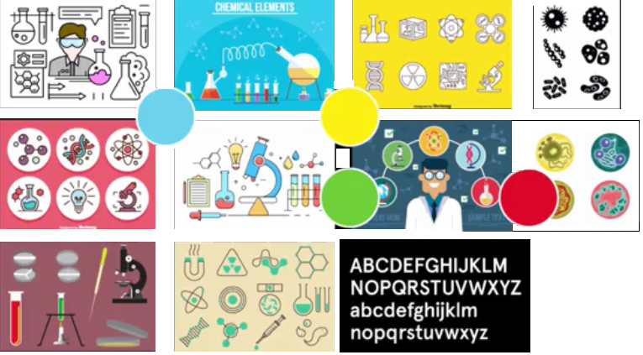
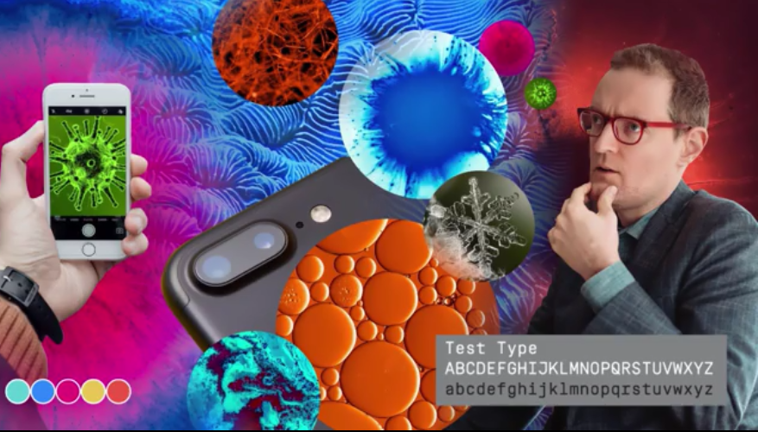
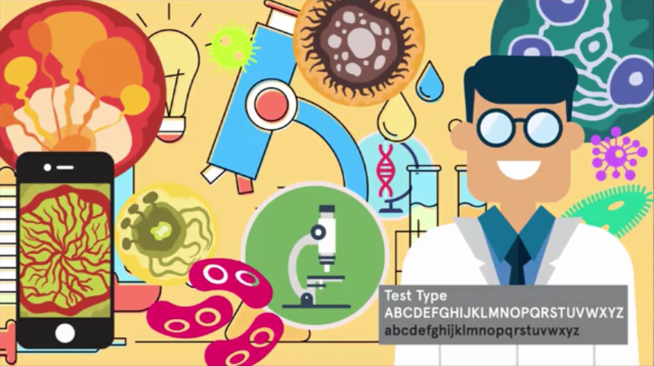
Пайдаланушыға бағытталған дизайн қағидаттары
Дизайнның формалды элементтері
Алдын ала дизайн
Жобаның стилі мен көңіл күйін анықтау уақыты
Алдын ала жобалау (өндіріс және міндеттеме)
Жоба мысалы: ғылымға әуес жандарға арналған цифрлық микроскоп
Телефонды микроскоп ретінде қалай пайдалануға болады?
Авторлық құқықсыз суреттер бе?
Notes:
Предварительное проектирование (предварительное производство, предварительное обязательство)Пример проекта: цифровой микроскоп для ученых-любителей
Now, that we've got a design brief, our project described in words, we can begin to think about making some design, we can begin to think about the broader sense of how design works in a UI project, the look and feel of the project. Another way to think about it is to think about the style and the mood of a project.
So, if you look at it in terms of style frames, for instance, you could think about what would it be like if a single slice of this project was to be finished and that's often done in motion projects. In print projects there's also a thing called a mood board where you try and paint a broad picture of research and the look and feel of a project. What all of these things are trying to do, and they're fairly interchangeable expressions, in that they're trying to envision the overall design direction and this is still part of pre-design. We're not really working with words now but we're working with very broad visual strokes. It gets us into a mode of pre-production and it's before we've really produced anything, it's pre-commitment as well. It's before we've really made any design decisions that we have to stick to and what that means is it's before you've really spent any money.
You have to get all the components right before a project goes into production and might cost millions of dollars where thousands of people might be using it and hundreds of people better testing it. So, it's important to get these things right before you go into production and this gets at the core of what a lot of UI design really is. It's about envisioning the design, it's about imagining that design, trying to give it a visual form even though it doesn't really exist. A lot of ways UI designer is trying to visualize the invisible and this is one of the most important skills that UI designers have. One of the easiest ways to start to do that is to start to look at style boards. So, if we go back to our original idea of a digital microscope for amateur scientists to operate on your phone, we could start to think about what that might look like. So, to begin with we could do some visual research, which is easy to do nowadays where you can go online, you can find copyright-free images, for instance, and we could look at what kind of images might look like they're seeing through a digital microscope. We could look at scientific images, we could look at how the phone could be used as a microscope and this will give us a range of what the imagery might feel like. We could pick a typeface as well that might have a suitable feeling or suitable style for this particular mood in this particular app. likewise, we could pick colors so we can have a color palette that we might use and these are all very very broad design elements that we're choosing.
For instance, here we’re picking a color palette just out of the imagery that we've already found to try and get a relationship between the color palette and the imagery. As you start to put these things together and do research, it means that you're creating a mood and a feeling of imagery, of color, of typography.
So, if we take those research images that we found, we could actually use those and we could build a single piece of work that has a mood and a tone that tries to reflect what we're trying to get at with our app.
So, I could take some of the microscopic images, for instance, and blow them up, create some gradations, have them feel very scientific and because this is for amateur scientists, we might want to depict exactly who it is that the app is for who's going to use it. We can also use certain kinds of shapes, for instance. Perhaps in this case circular shapes that might indicate looking through a microscope and have a visual reference to that. We could show what it's like to actually use the app. So, you can see somebody holding a phone, for instance, and looking at a close up of something through the microscope. So, we’re trying to get at what is the visual look and feel of this app but I'm also trying to get at what is the experience of it, what's going to feel like when it's finished product without really doing very much work at all, without making the finished product at all. We’re really just taking a group of images and trying to paint a very broad picture of what it might feel like to use this app without any details at all. So here, for instance, we could also look at some test type, we could look at a certain kind of topography, put the color palette back in there again. We’re ready building up a style frame that we could show to somebody and they could look at this and they could have an idea of what my intentions were and what the feeling of the app might be. As we mentioned, it's this apparent way of trying to envision something that is invisible. So, we started from one sentence that was described in text and we're trying to end up with something that is purely visual and has a lot of mood and a lot of feeling to it.
So, let's try doing that again but this time let's take a different visual approach. Let's take our same starting sentence. In other words, we're going to use our same prompt our same brief but we're going to take it in a different visual direction. So, here we're going to use much more vector-based imagery. It's going to look less hardcore scientific, it's going to look a little bit more fun, it might have a slightly younger audience. So, already even just from our initial visual research, it looks very different. So, even though we're taking the same visual brief, the same prompt of visual representation of it is very very different because we've made design decisions that have changed that. So we're going to put these images together in a very similar way that we put the scientific photographic images together, so we can compare the two and see how they feel different. So, let's take some of these vector drawings of scientific instruments and we will blow these up very large. They'll be much more friendly, a little more cartoon-based, we can have a more cartoon like Avatar to lead us through the project, for instance. We can look at some color palettes that are perhaps a bit more fun, again for more youthful audience. We could keep the circular motif that worked quite well from before, that seems to represent the idea of looking through the microscope. We can build this image in a very similar way but it has a totally different feeling than the more serious photographic scientific version we had before. This version now feels like it's a lot more fun, it could be for a younger audience and that might have some implications for how that might work, what it might do and how you might use it. We could throw some smaller free form elements in there as well to fill in some of the gaps. We can pick a different typeface for this one, it's a lot more fun.
So, let's pick something that's perhaps a bit more contemporary, less scientific. How about something that is a geometric sanserif, for instance, something that is quite neutral but quite contemporary as well. We'll do the same exercise where we'll take parts of the color palette and we'll use those so we'll pull that out of the imagery to make a color palette. So, you can see if we slot together these two different screens that we'd made, you can see how they feel very different even though they're using a lot of the same compositional elements, they're using a lot of the same ideas in terms of their content. So, to reiterate, it's really about the look and the feel and that has a strong relationship to who might use this kind of app. So, we're back to our original questions about what is the app exactly? Who is it for and where does it live? These two screens might take those questions into slightly different places. For instance, the one on the left might be much more scientific and serious and again the one on the right much more playful. If we take our two screens, we can analyze those and start to come up with some adjectives to describe them and that'll help us push that direction that we want to go in even further. So, we've made things that exist in a purely visual form in a very emotive and a very mood-based way, but we could actually turn that on its head and pull it back towards language in order to describe what we've done.

Slide 4
Пайдаланушыға бағытталған дизайн қағидаттары
Дизайнның формалды элементтері
Тіл — дизайн құралы ретінде
СИЯҚТЫ СӨЗДЕР:
Тон және қарым-қатынас
Ғылыми, Техникалық, Цифрлық шындық, Салмақты, Практикалық|Ғылыми, Ойнақы, Анимациялық, Достық, Көңілді
Атауы мен брендинг
Фотон, Occhiolino, аса жоғары айқындығы, ультрақұрылым|микроскоп, үлкейту, анықтау, қоңыздар мен бактериялар, ұялы телефон
Жарықтандыру, нанообъектілер, CMOS, sarfus|үлкейту (zoom), жасырын, мультфильм, жеңіл, бақытты, көңілді
Occtoscope, Nanoscope, Photonscope SeeCells, MicroFun, Magnozoom
Навигация
Үлкейту, Журнал, Жариялау|Масштабтау, Альбом, Көрсет және әңгімеле
Мазмұн
Жақсартылған окктоскопиялық көрінгіштік ғалымға нанонысандарды зерттеуге және өз зерттеу нәтижелерін жариялауға мүмкіндік береді.|SeeCells көмегімен әркім бактерияларды, микробтарды, жасушаларды және адамның көзіне көрінбейтін түрлі қызықты әрі күлкілі нәрселерді көре алады.
Notes:
In this section, we're going to look at how we use language as a design tool. In other words, how do we work with words? There's many different ways that we can do this on a variety of different scales within our project. We left our project thinking about what does it look like and what does it feel like? We've done that so far in a very visual way, using images and using icons, typography, color palette, and now we can think a little bit more about how this might work with words. How we could use words to describe the overall tone and attitude, much in the same way that we had a mood board describe that same thing visually. So, if we take our scientific example for the phone microscope for instance, we could think about what kind of words might we use to describe this if we didn't have the visuals there to do the job for us. So, it's definitely scientific, technical, there's a kind of realism to it but it's a very digital realism, maybe one that we don't always see. It's also quite serious, it's quite practical. So, it's quite useful to come up with a set of words, and those words won't apply to every design direction that you have. For instance, here's our second design direction and even though there's some things in common, it's still scientific for instance. I think there's other things that are very different about it. Again, about how it looks and feels, it's much less technical and much more playful for instance. The images are less about having a reality or a digital feel to them, a much more about being animated or cartoonish, and overall, that gives it a slightly different feeling if we had to describe that with words, it certainly wouldn't be that it's as serious as the other direction. It will be much more friendly, playful, and fun. Overall, we'd have much less of a practical feeling to this app, and maybe, it will be much more entertaining and much more fun to use. So we can take these sets of words that we've used to describe our app and we can think about those as a stepping stone to think about naming and branding. So one good thing to do is to do a bit of linguistic research and to try and play around a little bit with other words that are around the subject matter. So here's a collection of words that feel like they might relate to this app and how we might use it. So we can take inspiration from these words or we could actually take parts of the words themselves, which is a very easy strategy and think about how to combine them into a name. Maybe something that we recognize or something we don't. So for instance, we could think about a name like SeeCells because our app would allow us to see cells or, MicroFun. Which could be a way of having fun looking at small things. But while we're looking at the scientific basis of the language, we're also trying to put it together in a way that seems like it's fun, because that's reflective of our app. You can think about what the words describe, but you can also think about how they sound. Just the word Magnozoom, sounds like it's a lot of fun on its own. If we take our other example that's more serious and scientific. We might come up with a totally different set of words in our research. Even though we'll be looking at similar subject matter, we'd be looking at much more scientific words that hopefully see have a different kind of structure to them. So this would lead us to different kinds of names and different kinds of branding. But we'd use a similar structure, perhaps where we can take parts of these expressions and think about how we put them together to either make a new word that we've never heard of before or to make a word where we understand the parts where it's come from and we understand that it's making something new as well.
So, for instance, we might look at the name Nanoscope and understand nano meaning small and scope, talking about visional microscope and the word itself that we make sounds like it's a real thing even though probably isn't.
So let's compare our two directions that we have and pick names for them. Thus, we're going to call our scientific direction Occtoscope and we're going to call a more playful direction, SeeCells. We can think about how we use words in a number of other ways as well as branding. We could think about words as navigation, for instance. So if we were looking at something through our phones in the scientific world, we might be magnifying, but in the fun world we'd be zooming. Likewise, if we were going to save our image, we might save it to a journal in the scientific world, but a scrapbook in the fun world. If we wanted to share those images, we'd be publishing them in the scientific world where we might be doing a show and tell in the much more fun world. So you can see how doing the same thing can be described with a different attitude, with a different mood and we can use words as content to describe what it is that the whole of our app does as well and again the mood and attitude can come across in how we use those words. So our scientific microscope might use a much more academic language in order to describe it and in order to describe how the user might interact with it and what the user might do. Our fun version of the microscope might use very different language. Here it would be much less academic, much more informal, appealing to a much broader audience and with a little more of a fun attitude to it.
So you can see how we're using language to really describe something in a very different way. We're using it to set mood and to set the tone in the same way that we did with our images. So we're really looking at language as a design tool, we're looking at how it can be shaped and how it can be used in a variety of different ways. So language can set the mood and the tone, in the same way that our visuals did and it can do this at every level throughout your app.

Slide 5
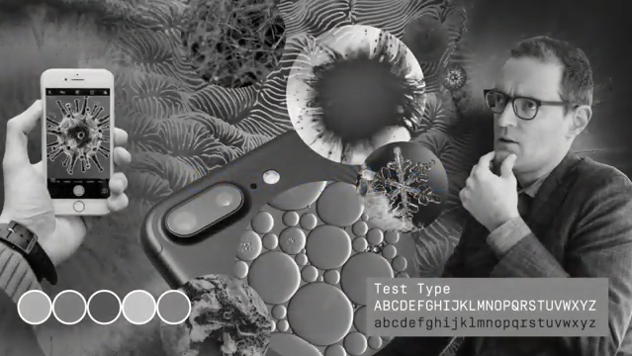
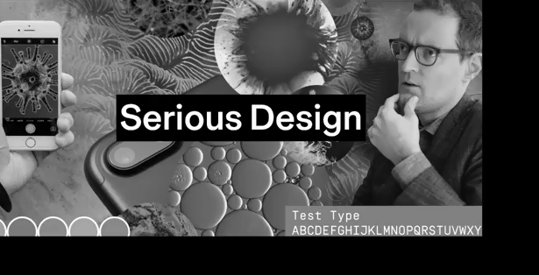
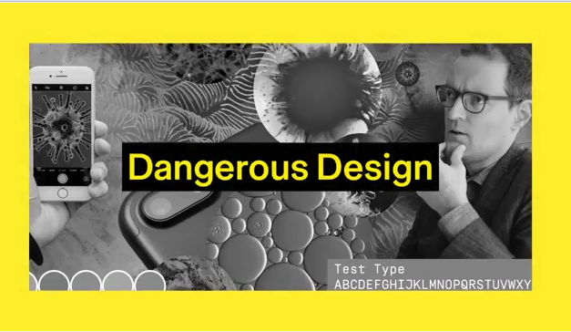
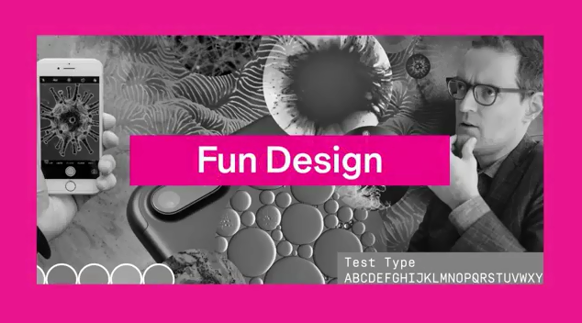
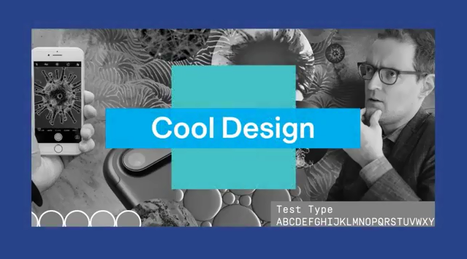
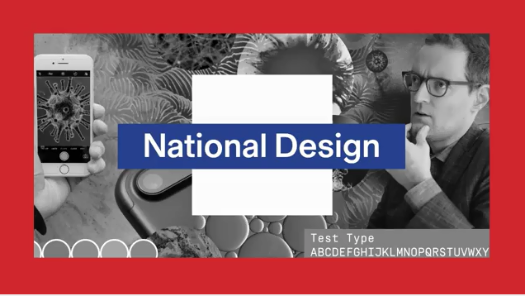
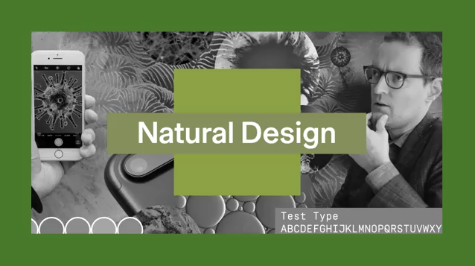
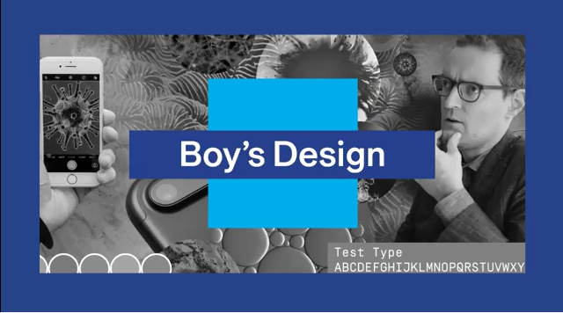
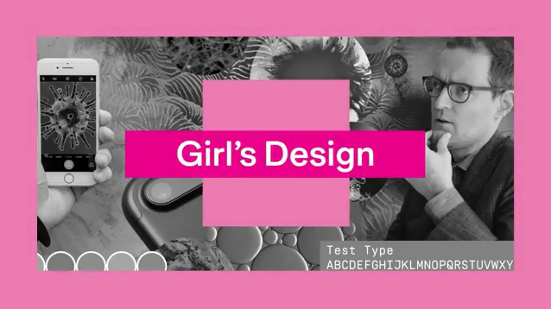
Пайдаланушыға бағытталған дизайн қағидаттары
Дизайнның формалды элементтері
Түс және форма
Көңіл күйді білдіретін түс
Notes:
In this section, we're going to look at how color and shape can work as formal elements of your interface design. So let's start out by looking at color in a little more detail. One of the main ways that color works is by creating an overall mood. And this can be really useful in that, because again it can set the tone if you want to be more serious or more fun. You might find a color palette that makes your app more believable. As human beings, we generally respond to colors, and we respond to them in a very subjective and emotive way.
So let's start out by doing a few exercises and looking at how color works. And let's take our scientific interface and let's take all the color away from it and start out with just black and white. When everything is just black and white we often have connotations with that of design being very serious, and that stems from cultural connotations of black and white printing in newspapers, early photography. But just by adding a simple color we can change those connotations. When we put yellow and black together for instance, we use to seeing that to represent danger. When we see a bright color, like magenta, we think that that something that's perhaps going to be fun.
So you can see how even just changing one color can create an emotion. If we start to put together a palette where we've got a range of colors working together in harmony, we could have a cool palette that might create a very icy or cold feeling. And when we start to change those colors, we could create other connotations. For me, red, white, and blue represents England. For other people, it might represent a different country. We could take a palette that comes out of nature, for instance, browns or greens. And we can build a palette that makes us feel maybe calm, or makes us feel a connection to nature. So there are some connotations that come from the real world and some that are fabricated. We see blue things, we might think it's a design for a boy and pink is a design for a girl, but those are just cultural conventions. Color is quite relative in a lot of ways and quite subjective. So we have to figure out how to control that and how to try and control that subjectivity a little bit. In order to get it to do what we want it to do for our interface, in order for us to help create an atmosphere, and a mood, as well as a function.

Slide 6
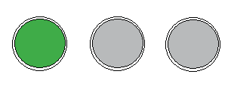
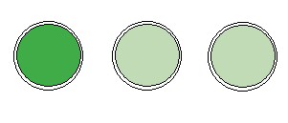
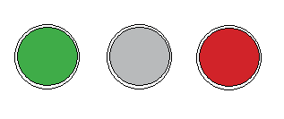
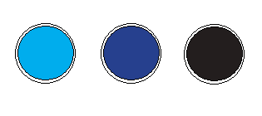
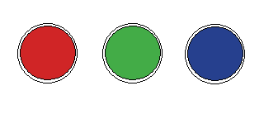
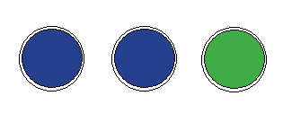
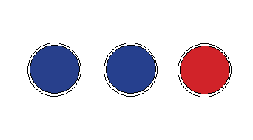
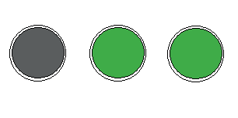
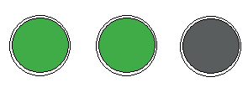
Пайдаланушыға бағытталған дизайн қағидаттары
Дизайнның формалды элементтері
Түс және форма
Түс — навигация құралы ретінде
Выбор кнопки
Выбор кнопки
Ассоциация
Похожая функциональность?
Различная функциональность?
Активная?
Неактивная?
Пассивная?
В прогрессе?
Notes:
And in terms of function we can use color in many different ways and a primary one is to think about how color works as navigation within our interface.
So for instance, if you have these three buttons and we ask you to pick one, I'm pretty sure you're going to press the green button, just because it looks like it's active. We're used to thinking that perhaps green makes it one to be picked, but also it's different from the other buttons. And we can use color to both create difference and similarity. So just by changing the other buttons here, the inactive buttons from gray to a lighter shade of green we build a different kind of relationship. Now they feel like they have the possibility to all be pressed and turned to the darker shade of green. And basically, what we're doing here, is creating a system that has differences and similarities. And that can also work in terms of association with other things that we've experienced before, either in interfaces or the real world. We think about green as being go or being active, and red as being stop or being danger. If we use colors that have a similar relationship, they can also build a sense of similar functionality.
So here we've got three buttons going from light to dark with a similar hue to them. And they might feel like they do the same thing but to maybe a different extent. Whereas if we have three different hues, we feel like that these three different buttons are going to have three different functions. We can use color in numerous ways. We could use it to denote something being active. Here just the green that's different from the blues suggests that something has been turned on, or is an active element. And we can take that same idea and take the green button and turn it into a red button to suggest it being inactive. As well as signifying an event or activity color also works as part of a system, here for instance we have one of three things selected. If you were to click on a blue button now, would it turn to red and would the red turn to blue? As well as showing us what's active, color can also show us what's inactive or passive. Here, the element is different, has a more muted color so we know that it's the thing that is actually not working rather than working. You could also think about how color can be used to show progression. In this case, we've got three possible stages, and it feels like we're two-thirds of the way to completion because we have two out of a possible three areas lit. We could also look at how color can show absolutely different states but within the same space.
So one button, one space, can take on different colors to tell us different things. So here, for instance, this button is grey. It's passive, or inactive, which means the user hasn't interacted with it at all. But once the user goes to interact with it, the button becomes active, not activated, but active. So this could be in a touch state or when a mouse is hovering over a button, for instance. And once it's actually been pressed, or clicked, or touched, then it becomes activated. So the same button is telling the user three different things just by changing its color. So now let's look a little bit at shapes and how we use shapes in user interface design. We primarily use shapes in two different ways in user interface design. One is interface elements, the buttons that you click on, the areas of navigation that you need to go.

Slide 7
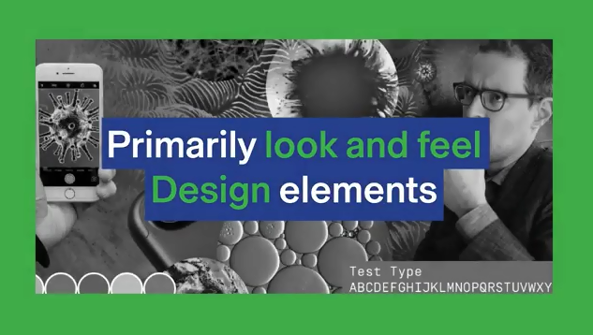
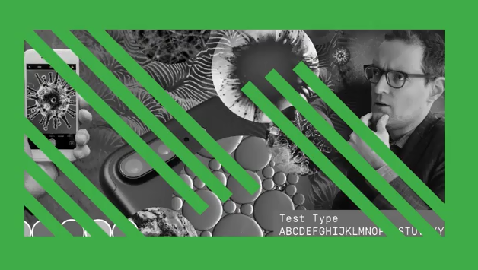
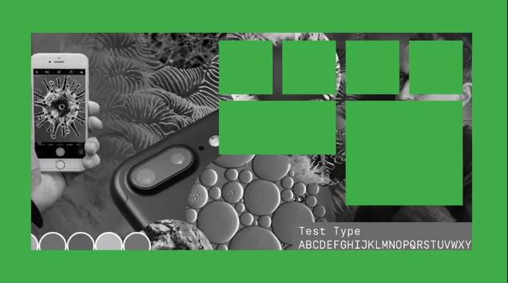
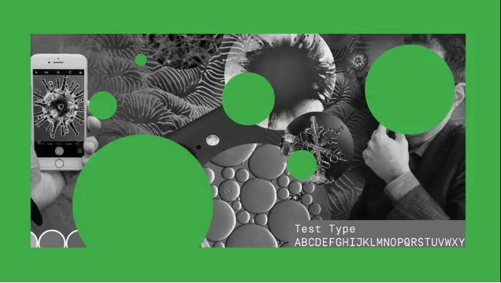
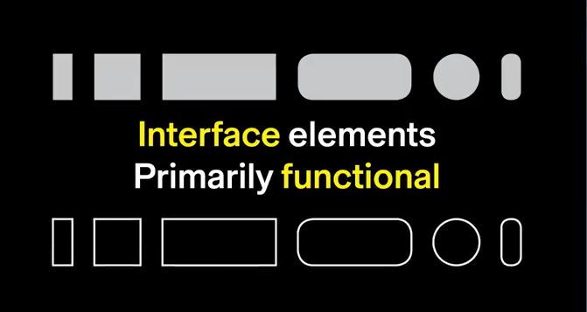
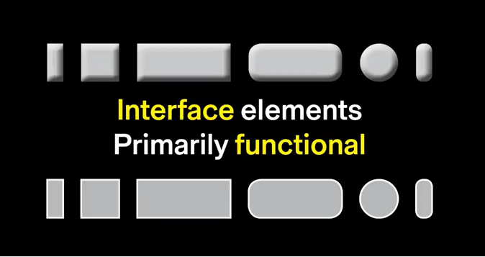
Пайдаланушыға бағытталған дизайн қағидаттары
Дизайнның формалды элементтері
Түс және форма
Пішіндер – интерфейс пен дизайн түрінде Формы как: Интерфейс и дизайн
Notes:
And the other is design elements, in other words, shapes that are mixed up with images that are more looking field. Our interface elements is primarily functional.
So we're talking about shapes that are worth as part of a system. But we also often geometric simple to understand easy for the user to access. When we use shapes designers elements they are often less systematic much more motive and sometimes more ephemeral. They're much more about the look and feel of the interface than they are about the functionality of the interface. And in this way, they often contribute to that look and feel, and not to the navigation itself. In many ways, they could be viewed as non-essential elements. But my argument would be that while they're no an essential part of the navigation, they are essential in terms of creating a mood, creating a sense of individuality and creating a graphic interface otherwise all interfaces look the same. Picking a certain kind of shape can have a big effect on the interface, whether it's a diagonal, or a square, or a circle, for instance - just as a basic form might make a difference between having a lot of direction, versus a lot of stasis, versus feeling very organic. We use shapes for our interface elements because of their functionality, and it's a certain kind of shape that we use. Normally ones that are geometric that a simple, that a systematic so that they can be fast to understand and they can make the system that's fast for the user to visually learn and to interact with. We're off to new shapes and motifs that we're familiar with as buttons in the real world. But the key thing here is that they have relationship to what is pressing the button on the active area. So whether that's the cursor of the mouse or whether it's the finger, we're building a system that relates to the user and how they interact with the content. But we're also making a system that's flexible, where we could label these buttons with anything that we wanted to.

Slide 8
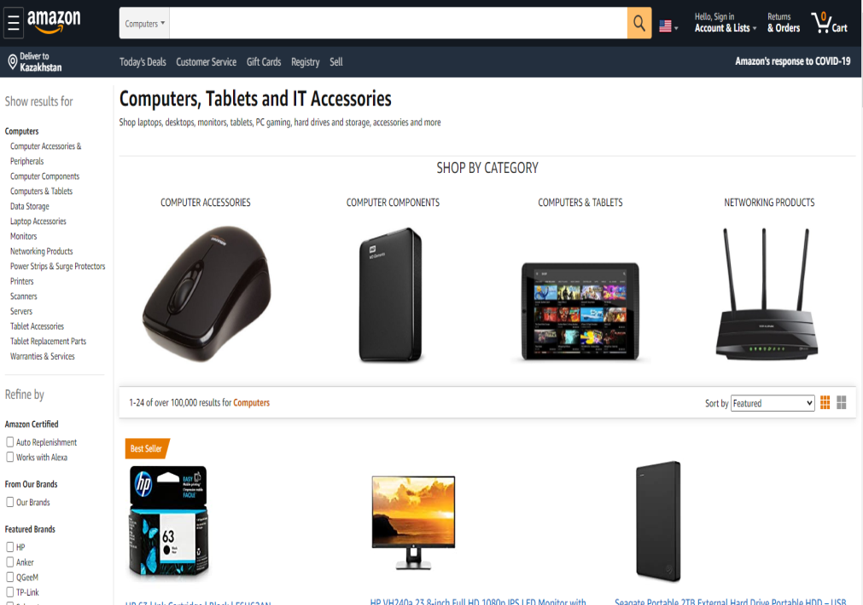
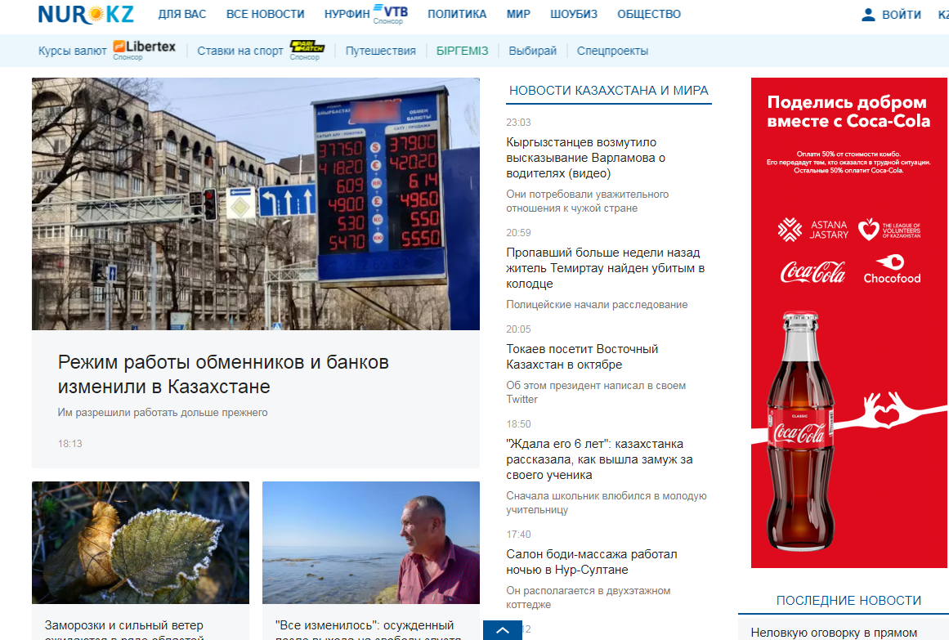
Пайдаланушыға бағытталған дизайн қағидаттары
Дизайнның формалды элементтері
Образы как интерфейс
ИЗОБРАЖЕНИЕ как СОДЕРЖАНИЕ
Сохраненные изображения
  Видео, поисковая система, все изображения
Notes:
In this section, we're going to look at how to use imagery in interface design. The most common use of imagery is as content in your app or on your website, but we can also use imagery to create a mood, or we can use imagery as part of our navigation, or part of our interface system. So, let's start out by looking at imagery as content. We live in an image based society where we're constantly surrounded by images. But on our screens, most of those images are contained. If you think about videos, or search engines, or the images that we look at online, they're nearly always images in boxes. So, they really content that's being shown in a frame here. That content can be anything. It's really not about being part of the interface, it's being the thing that we're delivering to the audience. So, if we're doing the search for instance, for something that we want to buy, we want to visually see all the different variations that we could possibly have, and the fastest way to do that is through imagery. That imagery is contained and organized.

Slide 9
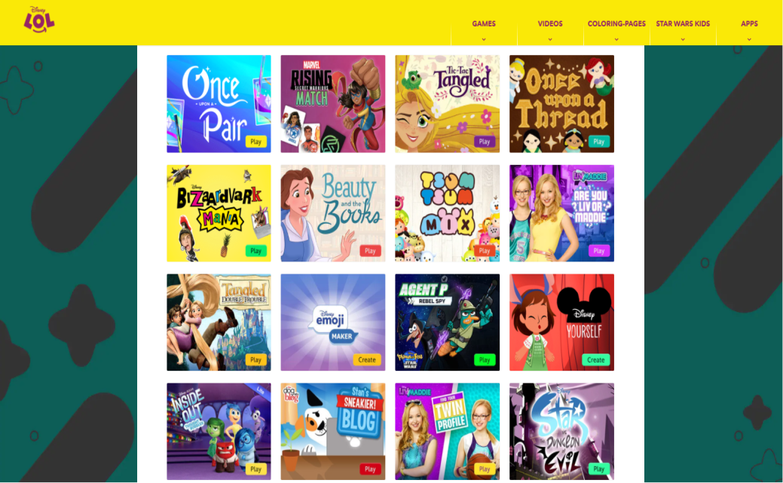
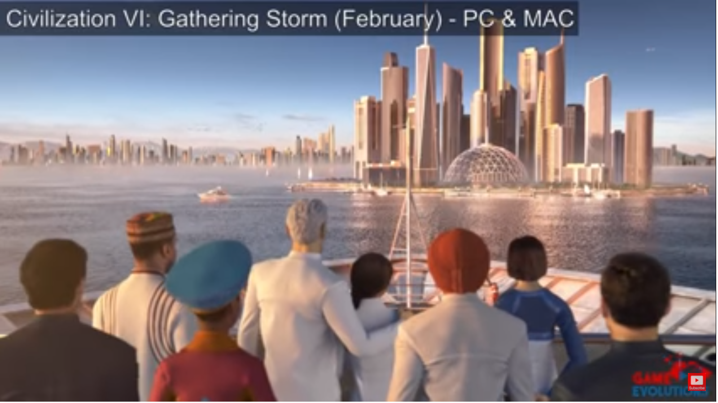
Принципы дизайна для пользователя
Формальные элементы дизайна
Образы как интерфейс
ИЗОБРАЖЕНИЕ как СОДЕРЖАНИЕ
Захватывающие образы
  Игры, приложения, анимации
Notes:
When images break out of the box, and become their own world, they act as immersive imagery. You see this much more often in games, sometimes in apps, but in animations as well, where the imagery creates a whole universe, a whole world, where things don't have to live in boxes anymore. The way we use contained images, is much more based on traditional graphic design. It's really based on print layout, where you have a grid, and you put things into a box. But in the immersive world, was a little bit more fluidity, it's based much more on video games, and animation, and film. You tend to have more of a correlation between what the interface looks like, and what the content looks like.
Both contained imagery, and immersive imagery, come in all different styles. So, there can be illustration, that can be photography, 3D renderings, pretty much any style that you want to make an image in. The benefit of the contained image is that, it's very pragmatic. You can put anything into a box, and have it sit side-by-side with anything else. So, you could take illustrations and drawings, have them sit next to photographs, and the grid, the boxes that you're putting them in, levels across all the content. So, becomes a very functional comparative structure for you to use in an interface design. So, you see it especially when you need to work across a lot of content that needs to be searched, or work across a lot of different sized platforms.

Slide 10
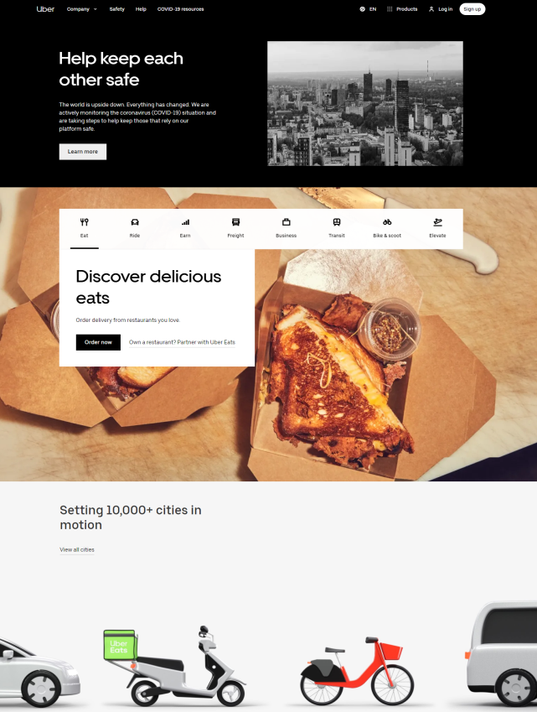
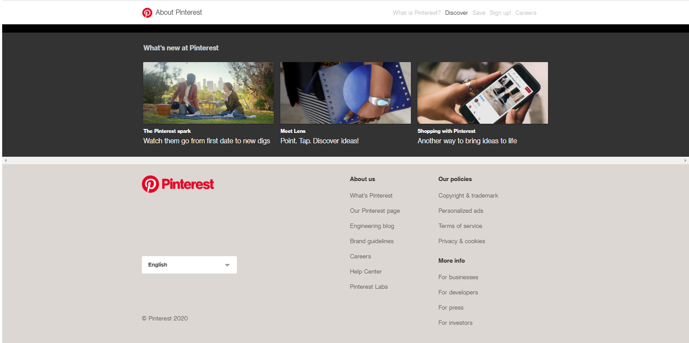
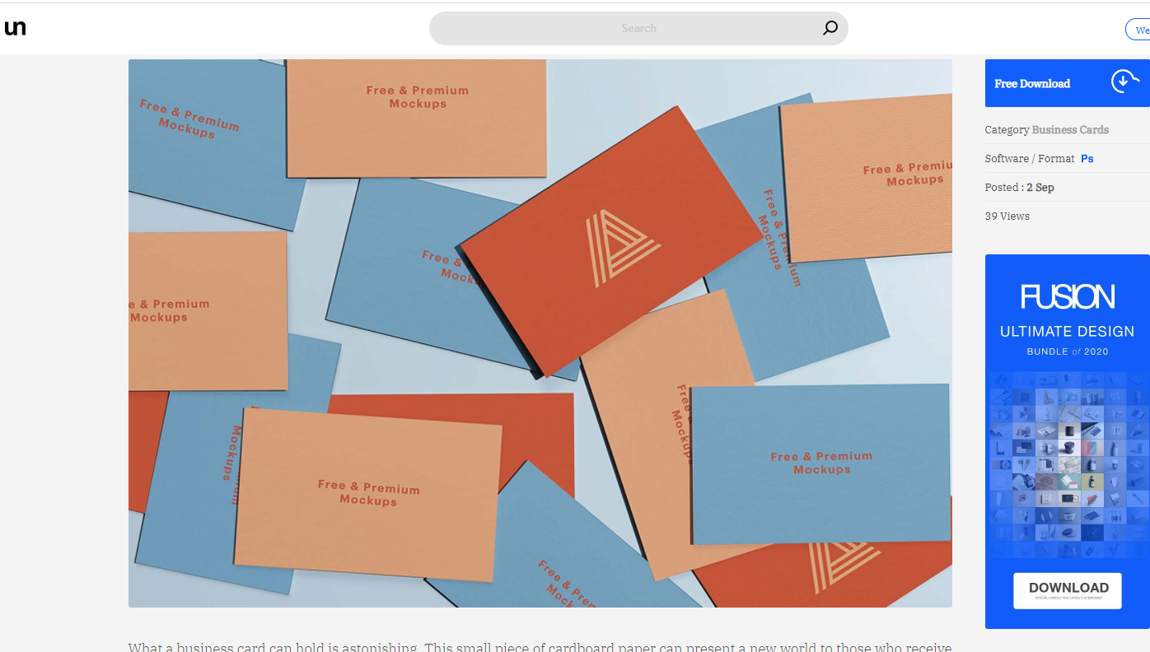
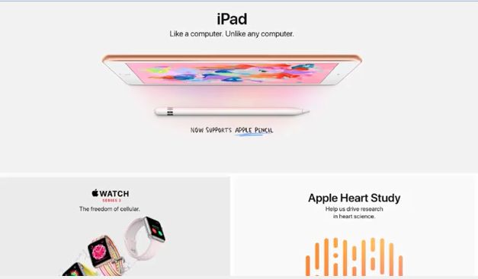
Принципы дизайна для пользователя
Формальные элементы дизайна
Образы как интерфейс
ОБРАЗ как НАСТРОЕНИЕ
Notes:
When imagery isn't there as the content, it's often there to create a mood. You might be designing an interface for an app that doesn't have a service that is image-based. So, for instance, Uber doesn't want to show somebody getting in and out of a cab, but they'd rather show a stylish illustration that makes it feel a certain way. Feel a little bit up market to set a tone for what the service is. You can see images working really hard to create moods. If you look at stock photo sites, the whole purpose of the photography here is to actually be non specific, and most of the time to create a feeling, or a mood that the audience is going to relate to, rather than having a specific content in the image. Sometimes when you look at mock-ups for websites that quite often using stock images to try and create the right ambience or mood, that's going to appeal to that particular audience or relate to that content. Due to good old aesthetics, imagery can't just be content. Imagery always has a visual form, and that visual form always has some style or aesthetic attached to it, so thereby, it creates a mood. Here's some images from CalArts website. While they're trying to depict the events that are happening at the school, they're also trying to have a visual form that expresses the energy, and exuberance of the school. Color, composition, and visual aesthetics, can be really important in creating an image that's going to engage an audience. That might be done in an overt way, where the image looks very constructed and clearly has a concept behind it, as in this example here. Or it can also be done in a way that's a little more invisible. These images from Apple, are very carefully constructed to show the products often their best slide, but to also sell a lifestyle, and sell an aesthetic that goes along with the Apple products. So, they're selling you both content, and mood lifestyle at the same time.

Slide 11
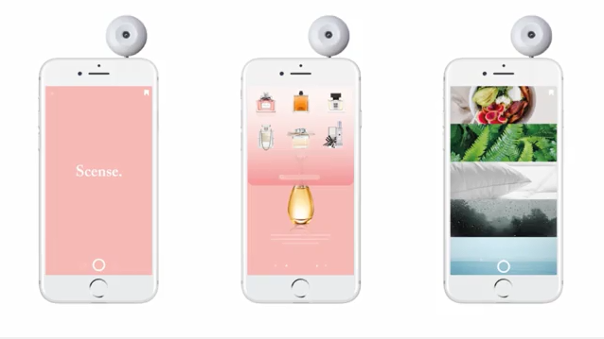
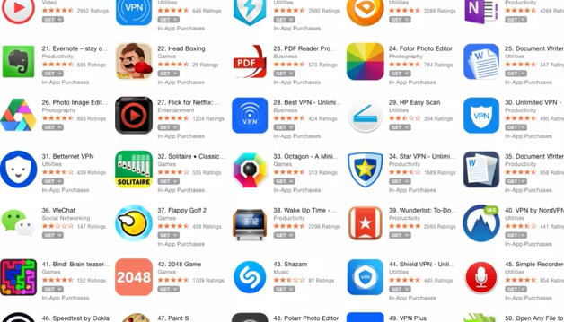
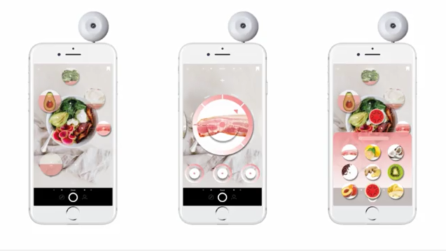
Принципы дизайна для пользователя
Формальные элементы дизайна
Образы как интерфейс
ОБРАЗЫ как НАВИГАЦИЯ
Notes:
Imagery can also be used as a tool for navigation, but most often, this happens in a very reduced form. Partly because the image has to work at a small size, but it also has to be very recognizable. But imagery can do much more than just being a symbol or an icon. Imagery can be a more integral part of the interface. Images can work really well as buttons as part of your navigation system. This is partly because they accurately represent exactly what you're going to get when you click on them, there's no ambiguity there. They can also work really well if the thing you're trying to represent is very difficult to describe with words, but easy to show with an image. As we already talked about every time you use an image, as well as doing whatever function you've assigned to it, it's also going to have an aesthetic function, there's also going to be mood and tone there. So, for instance, a map on Waze looks very different to a map on Google Maps. Waze is trying to create a visual aesthetic that suits its user base, suits its audience. It's trying to be more youthful, more fun, and perhaps, a little bit relevant. But along with the aesthetics, the map still functions in a pragmatic way. The symbols and the interface all work perfectly. So, our imagery is doing multiple things at the same time. It's acting as mood, it's acting is part of the interface, but it's also the content in this case as well, because it's the map itself, and the cars and the accidents, and everything that we want to see. So, you can see that happening here in this interface designed by one of my students, where it's purely an image based interface. So, the content, the navigation, and the aesthetics, are all being driven by the same imagery. That imagery is controlled and aestheticised to make a beautiful interface. So, you can have imagery as content, imagery that's there just for mood, or imagery that's there for navigation, but you can never avoid the aesthetics of the image. You can actually never avoid the mood. So, even if your content is the only place that you have imagery, it's going to have some implications for what the app or the website looks and feels like, and the same for your navigation. You can isolate the content and the navigation from the aesthetics and the mood of the imagery. You're always going to have to deal with it in one way or another. What this is acknowledging, is that we're creating visual interfaces here. What used to be called, Graphical User Interfaces. We're not creating just lists of words for our content, or we're not creating just words for our navigation. Everything has a form, and because it has a form, it has an aesthetic value, it can create a mood. There's no way of escaping that. Your content will always have mood, and your navigation, or interface design will always have mood as well. So, it's really worth thinking about the visual aesthetics, and how you use imagery, and the quality of the imagery that you have, because you can't escape the fact that it's going to have an effect on the user.

Slide 12
Принципы дизайна для пользователя
Формальные элементы дизайна
Типографика
Тип: как Контент, как Интерфейс, как Брендинг
Почему мы вообще читаем с экранов, когда для передачи информации у нас есть видео и аудио?
Текст — это язык, ставший физическим объектом
Текст быстрый
Текст точный
Текст экономичен
Текст может представлять то, что невозможно изобразить
Notes:
In this section, we're going to look at some ideas around the use of typography in the user interface. Type can work in many different ways, as text that can be the content for your app or your website, it can act as part of the interface in terms of labels and buttons or it could be part of a branding system to give your app or website an identity. Let's start out by looking at Type as content. Why do we even read on screens anymore, when we have video and audio to get our information through? Well, the answer is that text does quite a few things that it's quite good at. It's language made physical. Text's very fast so it's very accessible, it's quite accurate in terms of trying to describe something, it's very economical in terms of how it works on a screen, but most importantly, it can represent what can't be depicted. If we think about how text translates to texting, we can see that the things that text is good at get amplified even more. Texting becomes faster, becomes more economical, it starts to use images, emojis in with the text itself. On screen, we start to change the very structure of language, as well as changing what we consider to be a typographic character.

Slide 13
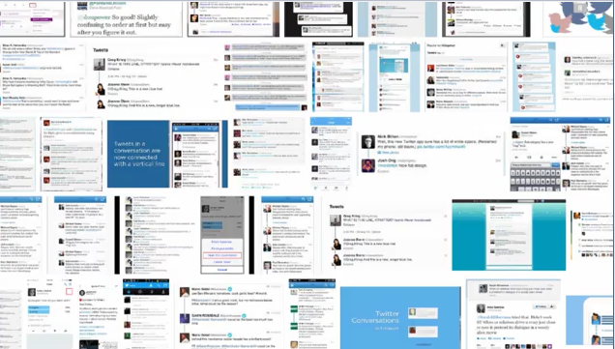
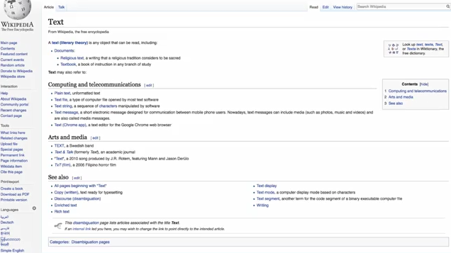
Принципы дизайна для пользователя
Формальные элементы дизайна
Типографика
Тип: как Контент, как Интерфейс, как Брендинг
Notes:
Far from being eclipsed by video, and audio, and images, text is becoming more of a prevalent means of communication on the screen, and if anything, it's absorbing imagery into its language. It's also starting to reconfigure itself, to alter itself to work in a new digital realm. Websites, blogs, texts, tweets, they're all fundamentally text-based still. That text has to have a visual form, it has to have a typographic representation. So, it becomes a design problem, it becomes part of an interface design. We don't really think about it so much, but text is still one of the main vehicles that we use for carrying knowledge, and for imparting and sharing that knowledge through digital media.

Slide 14
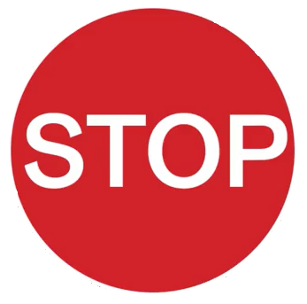

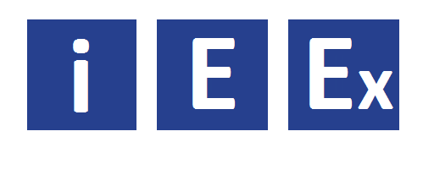
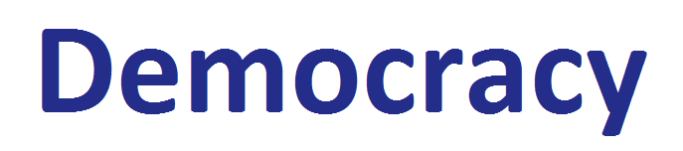
Принципы дизайна для пользователя
Формальные элементы дизайна
Типографика
Тип: как Контент, как Интерфейс, как Брендинг
Зачем нам нужен Тип как Интерфейс, если у нас есть иконки?
Текст — это язык, ставший физическим объектом
Текст быстрый
Текст точный
Текст экономичен
Текст может представлять то, что невозможно изобразить
Тип в:
- меню
- именах
- кнопках
- инструкциях
Notes:
So, Type has an integral role in terms of how it works as content, but it also has an integral role in terms of how it works as part of the interface, and this is because Type can do things that images and icons can't. So, we can ask ourselves the same question. Why do we need Type as part of an interface? Why don't we just have icons for everything? A lot of the answers to why we have Type as part of our interface are the same as why we use text for content. It's language made physical, and it has all the advantages of language, Type's very fast, it's accurate and clear meaning, and economical, and also, again, it can represent what can't be depicted. So, let's look at some examples. Type is fast to read. When we see a Stop sign, for instance, we know exactly what it means straight away. We barely even have to read the Type, we recognize the form of the Type, and it has a very accurate and clear meaning. There's no confusion there. There's no ambiguity at all. Stop only means one thing, "Stop." And Go only means one thing, "Go." There's absolutely no gray area there. There's no interpretation, and this can be very useful in terms of designing an interface. Language is very economical in terms of its meaning, not just a single word either. We can take a letter and we can use that to represent something. So, we know that this I stands in for information, for instance. But we also know that a P, part of the same alphabetic system, has a totally different meaning, and mean something else. There's a level of modularity and flexibility to language, we can add another letter to that P and have the meaning totally change, even though the form itself hasn't changed. In fact, the form of all three of these images is the same, but the meaning is very, very different. So, language has a great deal of flexibility in terms of how it works. It can also be useful in terms of interface design because it can work at greatly different scales. Sometimes, images don't have that same flexibility, and we end up making icons or symbols, often out of Type, but most importantly, Type can represent what can't be depicted. It takes a little moment to unpack what this statement really means, but think about, as an example, a word like "democracy." How would you represent this word visually? It would actually be quite difficult. There's not really a single iconic image to represent democracy, it's always going to be a little bit more ambiguous as an image, than it is when it's represented with language. Even the words surrounding democracy that might describe it, government, voting, elections, politics, when you turn those into the form of imagery, they still have a lot of overlap between how they might be read. So, words are great for the accurate representation of complex non-visual concepts like democracy, for instance, and this is great for an interface designer because quite often, we'll be trying to show things that are complex non-visual concepts, and these appear in a lot of different places, in menus, naming, buttons, instructions. In fact, Type is everywhere in our interface because it's still the fastest and most accurate way we have to communicate complex and specific ideas.

Slide 15
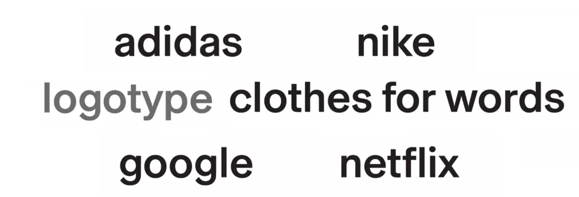
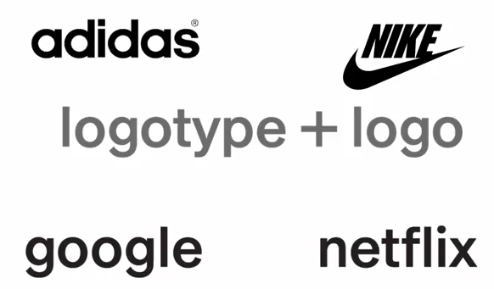
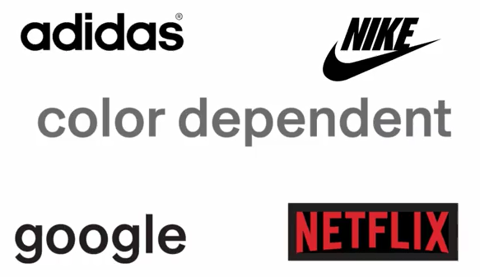
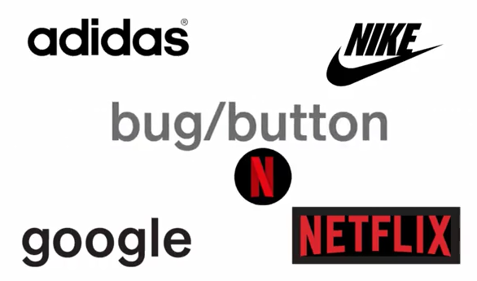
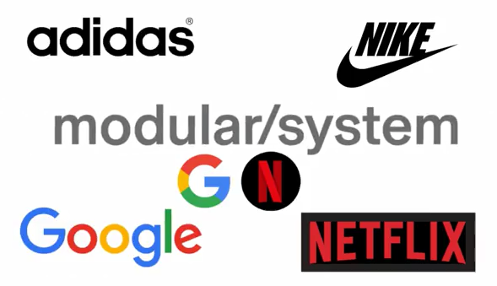
Принципы дизайна для пользователя
Формальные элементы дизайна
Типографика
Тип: как Контент, как Интерфейс, как Брендинг
Коннотация + Индивидуальность = Брендинг
Notes:
Finally, let's look at Type as branding. Here, Type has a slightly different job to play. It's much less about it being content, and about it conveying what it actually says, and it's much more about connotation. In other words, what does the form of the Type look like? What kind of things does it suggest? This can be a way to create a sense of identity or individuality, and this can lead to a visual typographic brand, that can be really, really helpful, in terms of making your app or your website stand out and look different for everybody else or it can be a way of making it build sympathy to a certain kind of content. The combination of idiosyncratic or individual form, and the right kind of formal connotations, can lead to branding typographically, most often expressed as a logotype. So, if we look at some examples here, we could take some large companies and see what they look like without any form. Typographic form is a lot like clothes for words, the meaning is still there, but it's dressed up with a different surface, a different form. I'm willing to guess that it's hard for you to look at these words and not think about the intrinsic form that these logotypes are normally seen in. We're used to seeing Adidas look a certain way with it's round repetitive forms. We're use to seeing Nike as both a logotype, the typographic form, and as a mark or a logo. In other words, in this case, the swoosh, and we see those things separately, and recognize them, but we also see them together. The logotype and logo work together in harmony to form a single lockup. There are other systems that you can use to think about, to create an identity typographically. Some of them could be color dependent, for instance, Netflix, we see as being red and black, and when we look at the logotype, and then we look at a smaller version of it, a bug or a button, we can see that it's not the same letter form that's there, it's actually the color that is creating the continuity between the two different versions. You can take this idea of flexibility, or an extended system to an even greater extent, and think about a much more modular system that can be applied to a lot of different artifacts, or might even be a system where things change depending on the time of day, or the time of year. I think Google is a good example of a wider system, in terms of other new identities applied to a lot of different components, but also how they create a set of sympathetic imagery that's forever changing. The big takeaway here is that Type matters. If we turn these logotypes back to a more generic black and white form, we can see how much they lose, in terms of being recognizable, and in terms of their individual identity.

Slide 16
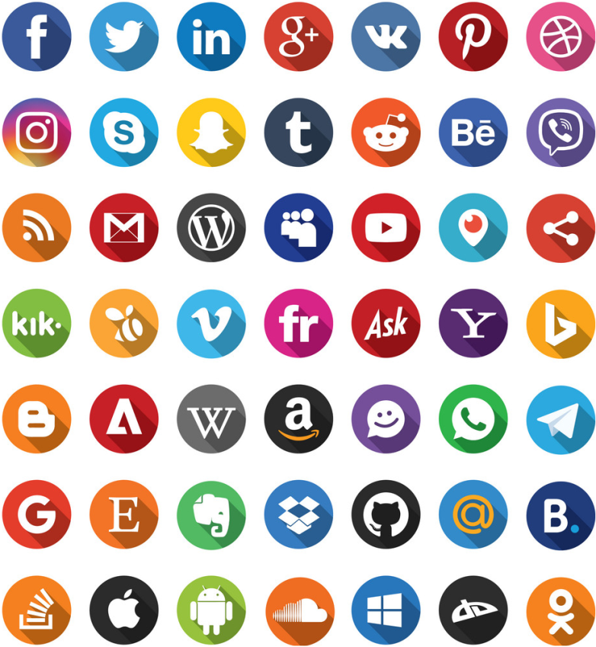

Принципы дизайна для пользователя
Формальные элементы дизайна
Иконки
Иконки как распознавательные представления
Иконки из реального мира
Notes:
In this section, we're going to look at icons and see how icons work as part of our user interface. We're very familiar with icons. We see thousands of them every day. Every app has to have a visual representation of what that app is in a small and condensed form where the user can recognize it. So, every app has an icon or symbol to represent it and those icons or symbols have to compete with each other and there are thousands of them all vying for your attention. Trying to create visual interest and trying to be recognizable. But there's another place where we also see icons and symbols working and that's in the interface itself. These icons were based on objects in the real world and it's interesting to see how little they've changed over the last 20 years where their form has been modified, the essential essence of the icon has stayed the same.

Slide 17









Принципы дизайна для пользователя
Формальные элементы дизайна
Иконки
Значки и символы
известные
изученные
Notes:
One of the things that people often get confused about is the difference between an icon and a symbol. Part of this reason is we tend to use the word icon for both symbols and icons, so let's look at what the difference is between the two of them. Both of them represent other things. An icon does that by showing us a picture of the thing. It shows us a visual representation of it that is relatively realistic compared to what the object is. So, in this case, here's a set of headphones and it looks like the headphones. But a symbol doesn't necessarily look like the thing that it represents. So, for instance here's music and it's represented by nodes. So, the icon is pictorial, whereas the symbol is non-pictorial. It's not an accurate visual representation of the thing that it's representing. It will be hard to represent something as broad and something as abstract as music with a fixed single visual image. So, to sum it up icons really do look like the thing that they're representing and symbols tend to not look like the thing that they're representing. One is pictorial and the other is non-pictorial. So, sometimes, you're going to want to create an icon to represent your ideas and sometimes, you're going to want to create a symbol. It really depends on what the thing is that you want to represent. For instance, a dagger is very easy to show a picture of, but if we're talking about a concept, something as abstract as thought for instance, it's quite hard for you to think of an image of that, so we have to create a symbol to represent that concept or that idea. It becomes a little confusing when things are ambiguous and can work as icons or symbols. This lightning bolt for instance could be an icon because it's a picture of lightning but it could also be a symbol for electricity. Something that doesn't necessarily have a visible form but needs a symbol to represent it. Often we can assign meaning to things that can make them work as icons and symbols. So, as an icon the magnifying glass looks like a magnifying glass, so it represents that but as a symbol, it stands in for the idea or concept of searching. What's interesting about the magnifying glass is we use this as a very common icon for two different things. We use it when we want to zoom in and zoom out, which is its iconic function, but we also use it when we want to type text into search for something, which is its symbolic function. Our interface elements can work as icons and symbols but so can our branding elements. Here is something that we instantly recognize, but not so much in its iconic form as apple the fruit but in its symbolic form as Apple the company. That's to do with our particular familiarity with this rendering of the form of an apple. It becomes a symbol that is representative of a company that we've all learned to make a connection to. We don't even see an apple and think of food anymore when we see it drawn in this way, we can only think of the company. So, the symbolic representation in this form has totally eclipsed the literal depictive value of it. Some of the best icons or symbols tend to keep hold of their literal value and their learned value. So, let's look a little bit more at how that works. We can have icons that work in a purely iconic way but they can also overlap and become a symbol, and in the same way, symbols can overlap and become icons as well. If we can enter this middle ground where we can get the value from both the iconic meaning and the symbolic meaning, it gives us a much richer element to work with. So, we're trying to connect the meaning between the icon and the symbol to create this very rich graphic element that we can use in our interface or we can use in our branding. The goal here is to combine what is known, what is visually obvious with what is learned. In other words, what is associative and might not be visually obvious. Let's look at some other examples of icons and symbols that are commonly used in interfaces. We use a pair of scissors to represent the idea of cutting and pasting but in the real world, scissors actually function just as devices for cutting and mostly just for paper, not for files or text or other things in the digital world. Likewise, a trash can is the place that we throw files away. We delete our files there, but we're not actually physically throwing anything away, we're dealing with digital files that we're deleting off our computer but a metaphor from the real world, helps us understand how to operate in the digital world. Likewise, if we wanted to send an email, it doesn't actually look anything like a letter, but we're used to seeing this symbol to represent the idea of sending electronic mail. So, we use antiquated things from the real world to represent new things in the digital world. Symbolic meanings have to be learned, so when we look at this image of a bird, we don't actually connect it to a bird, we connect it to Twitter, the company. So, we know that when we click on this bird, we're going to send a tweet. We're not going to go to a bird watching site for instance. So, there's a connection here between how our interface elements might work and have meaning and how our branding elements work and have meaning. To put it another way, quite often there's a merging between identity and interface. You can see this with something like Twitter for instance. If we look at the wide range of visual representations of that particular company in a symbolic form, where any of these things could be buttons and we'd know exactly what we were going to get if we clicked on them, we're going to get to Twitter. We're not going to get to a page that's about bird songs.

Slide 18


Принципы дизайна для пользователя
Формальные элементы дизайна
Иконки
Идентичность и интерфейс
Что делает иконку удобной?
Коммуникация (идеи + эстетика)
Функциональность (техническая)
Аудитория (пользователь понимает!)
Узнаваемость (насыщенность + простота)
Notes:
In this introductory class, we're only really going to touch on these ideas of creating symbols and icons for both interface and identity. If you were doing this in the real world, this would be a specialization where you'd be really working as an icon designer and doing very little else in part of the UI/UX process. So, we can look at something like Google and see how much work goes into really extending that system across a number of different icons and creating a really strong visual identity. A lot of time and effort and precision is put into creating each of these icons or symbols. So, again, it becomes quite a specialist job within the UI/UX world. So, let's look at some simple rules for what might make a good icon. Think about what you want your icon to communicate. It needs an idea and it needs to communicate that through its aesthetics as well. Think about its functionality. It's got to work at different sizes, it's got to be clear and legible. You could think about the audience. It has to be recognizable and it has to be understandable and lastly, think about visual recognition. This could come from saturation from seeing your icon everywhere or it could come from just creating a simple striking and memorable icon.

Slide 19
Принципы дизайна для пользователя
Спасибо за внимание !

