Slide 1
2-модуль. Пайдаланушыға арналған дизайн және өзара әрекеттесу взаимодействие
CSE 5442 Адам-компьютер өзара әрекеттестігі
6-дәріс. Интерактивті дизайн қағидаттары.
Лектор: ф.-м.ғ.к., ассоц. профессор
Ягалиева Багдат Есеновна

Slide 2
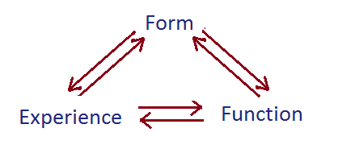

Интерактивті дизайн
Static to Active Пайдаланушы интерфейсі: статикалықтан белсенді өзара әрекетке көшу
Form is always connected to the Function
Пішін мен функция әрқашан өзара байланысты
Notes:
Most design projects have a brief, and a brief outlines or describes the project before you even begin designing. The brief itself is kind of a design project in its own way. So, it's interesting to look at this idea of, "what's in a brief?" A brief often describes what the project is, what its goals are, and how it's going to work. So, this involves looking at content, context, and audience. We need to define...
What is it?
Who is it for?
Where does it live?
Without this clear articulation of these goals, you could be making something for weeks or months without it really achieving what you wanted to achieve. So, let's look at how these three questions might work in a brief and let's look at some examples.
For instance, if we thought about what is it, let's come up with an idea. Perhaps we want to make a dombra tuner, that's something that could be quite interesting to exist on a digital platform. We can also think about who is it for, let's say that it's for beginning dombrists. It's not for master dombrists that might already know how to tune their dombra. It's really for novices - people that are just starting out and might need some help. We could also think about, where does it live? It would be logical for this to live on a phone app, so that it could be possible, it could be easy to carry around and something that we could use hands-free when we’re tuning our dombra. So, when you put these things together, you've got an accurate description, it's a phone app to tune your dombra for beginning dombrists. This is entirely non-visual but we've already started to give some shape to our idea. We've already started to describe it with words and this is pre-design. It's really design that outlines or defines what the project is before you've even made anything.
So, let's try it again. But let's think of a different subject this time. How about an app for students who need chocolate bars or crisps for late-night study breaks. This app will allow you to find a specific food within a given area. It will be the main goal.
Now let’s think about other subject. How about a digital microscope? That sounds like something that could be quite interesting to make as an app and that could utilize a lot of what a phone can do. So, who is it for? In this case, it's going to be for amateur scientists. So again, it's not for the novice but it's also not for the expert. A proven scientist might need something much more technical. Where would it live? It would seem again that this would work as a phone app best of all so it can utilize what a phone is good at. It could use the camera in the phone and it could use the screen of the phone to look at what you're magnifying. If we put these things together, we'd have an accurate description of what the project is, who it's for and where it's going to live? A digital microscope for amateur scientists on your phone. Again, it's purely non-visual. It really just describes the project using words. We've articulated what it is so when we start to make something, we've got a clear set of goals. This is really important to know that our goals, constraints, platform, audience, all of these things are going to shape and inform the design and quite often the designer doesn't get to decide these things. These things are determined by the client. Often, they're determined by the client in the brief, before the designer even gets a chance to think about them or work with them.
So, if you want to be a good designer you're going to need what the goals are? What the constraints are? What kind of platform your project is going to live on? Who the audience is? Because these things will inform your design. What this means is, you really need to know your project, you need to understand every aspect of it so you can make the best possible visual solution for it. More than anything, you need to be the expert no matter what kind of content you're going to be working with. You should be the expert as a designer, but also be the expert in terms of the content that you're working with.

Slide 3
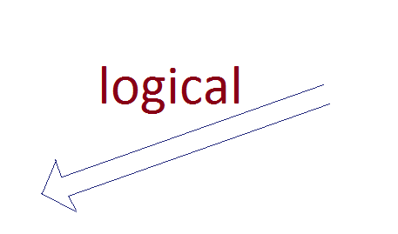
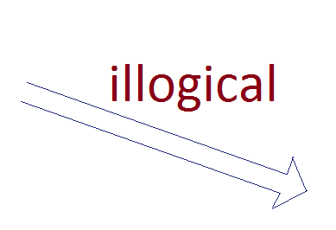
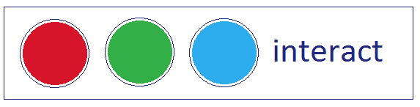
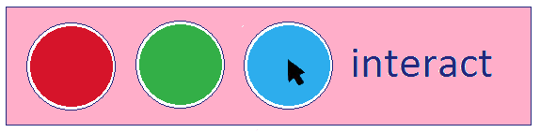
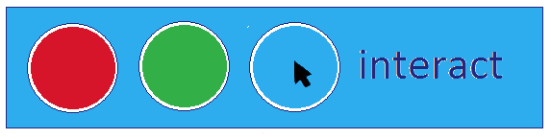

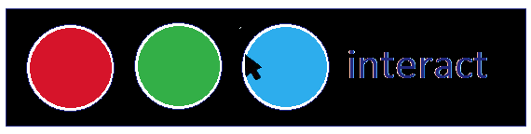
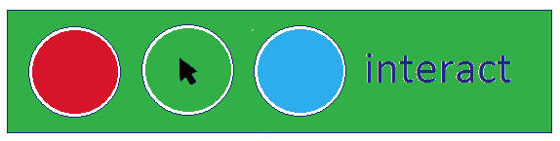
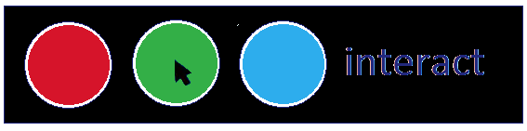
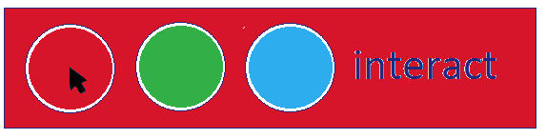
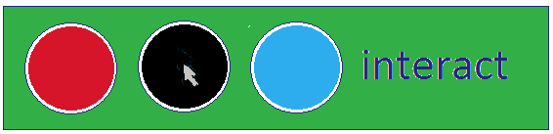
Интерактивті дизайн
Функционалдық (Functionality)
Интерфейс қалай жұмыс істейді? Біз жүйемен қалай әрекеттесуді қайдан білеміз?
Notes:
Most design projects have a brief, and a brief outlines or describes the project before you even begin designing. The brief itself is kind of a design project in its own way. So, it's interesting to look at this idea of, "what's in a brief?" A brief often describes what the project is, what its goals are, and how it's going to work. So, this involves looking at content, context, and audience. We need to define...
What is it?
Who is it for?
Where does it live?
Without this clear articulation of these goals, you could be making something for weeks or months without it really achieving what you wanted to achieve. So, let's look at how these three questions might work in a brief and let's look at some examples.
For instance, if we thought about what is it, let's come up with an idea. Perhaps we want to make a dombra tuner, that's something that could be quite interesting to exist on a digital platform. We can also think about who is it for, let's say that it's for beginning dombrists. It's not for master dombrists that might already know how to tune their dombra. It's really for novices - people that are just starting out and might need some help. We could also think about, where does it live? It would be logical for this to live on a phone app, so that it could be possible, it could be easy to carry around and something that we could use hands-free when we’re tuning our dombra. So, when you put these things together, you've got an accurate description, it's a phone app to tune your dombra for beginning dombrists. This is entirely non-visual but we've already started to give some shape to our idea. We've already started to describe it with words and this is pre-design. It's really design that outlines or defines what the project is before you've even made anything.
So, let's try it again. But let's think of a different subject this time. How about an app for students who need chocolate bars or crisps for late-night study breaks. This app will allow you to find a specific food within a given area. It will be the main goal.
Now let’s think about other subject. How about a digital microscope? That sounds like something that could be quite interesting to make as an app and that could utilize a lot of what a phone can do. So, who is it for? In this case, it's going to be for amateur scientists. So again, it's not for the novice but it's also not for the expert. A proven scientist might need something much more technical. Where would it live? It would seem again that this would work as a phone app best of all so it can utilize what a phone is good at. It could use the camera in the phone and it could use the screen of the phone to look at what you're magnifying. If we put these things together, we'd have an accurate description of what the project is, who it's for and where it's going to live? A digital microscope for amateur scientists on your phone. Again, it's purely non-visual. It really just describes the project using words. We've articulated what it is so when we start to make something, we've got a clear set of goals. This is really important to know that our goals, constraints, platform, audience, all of these things are going to shape and inform the design and quite often the designer doesn't get to decide these things. These things are determined by the client. Often, they're determined by the client in the brief, before the designer even gets a chance to think about them or work with them.
So, if you want to be a good designer you're going to need what the goals are? What the constraints are? What kind of platform your project is going to live on? Who the audience is? Because these things will inform your design. What this means is, you really need to know your project, you need to understand every aspect of it so you can make the best possible visual solution for it. More than anything, you need to be the expert no matter what kind of content you're going to be working with. You should be the expert as a designer, but also be the expert in terms of the content that you're working with.

Slide 4
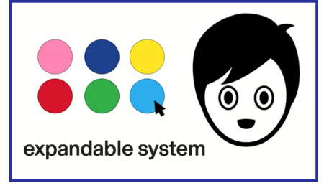
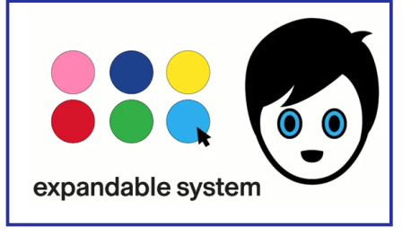
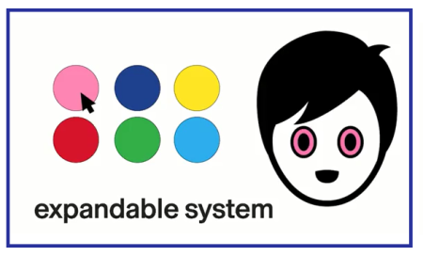
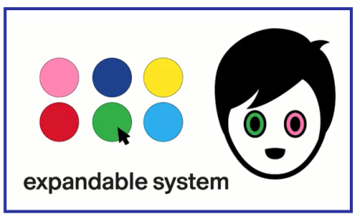

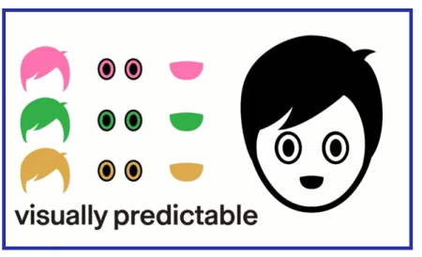
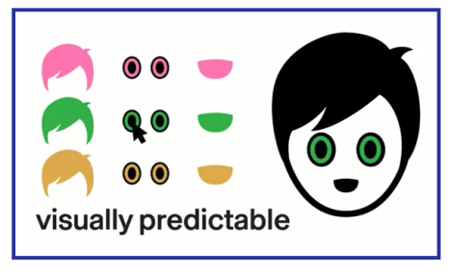
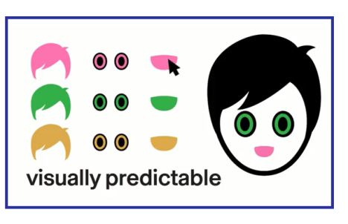

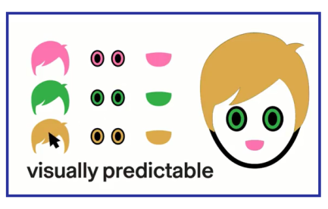
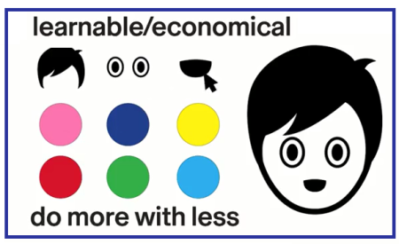
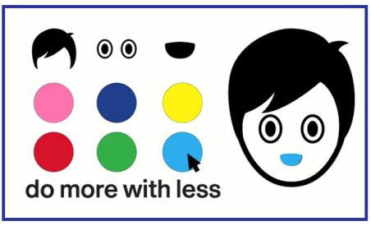
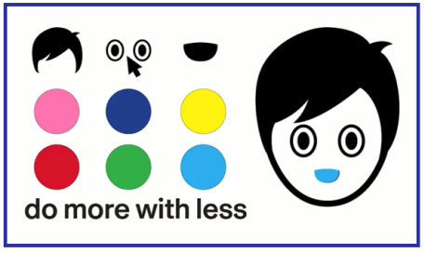
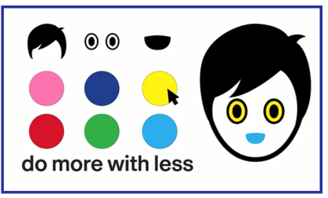
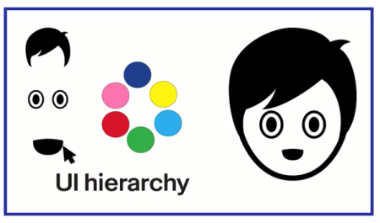
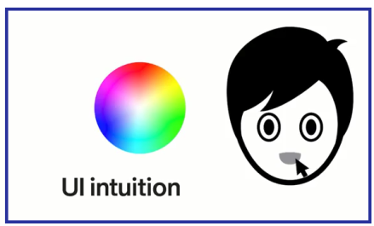
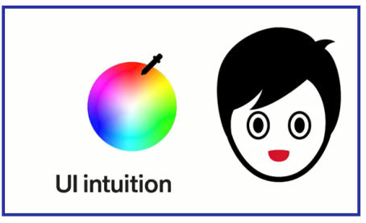
Интерактивті дизайн
Функционалдық (жалғасы.)
Logic + Hierarchy + Systematic = Intuition + Discovery + Learning
Notes:
Most design projects have a brief, and a brief outlines or describes the project before you even begin designing. The brief itself is kind of a design project in its own way. So, it's interesting to look at this idea of, "what's in a brief?" A brief often describes what the project is, what its goals are, and how it's going to work. So, this involves looking at content, context, and audience. We need to define...
What is it?
Who is it for?
Where does it live?
Without this clear articulation of these goals, you could be making something for weeks or months without it really achieving what you wanted to achieve. So, let's look at how these three questions might work in a brief and let's look at some examples.
For instance, if we thought about what is it, let's come up with an idea. Perhaps we want to make a dombra tuner, that's something that could be quite interesting to exist on a digital platform. We can also think about who is it for, let's say that it's for beginning dombrists. It's not for master dombrists that might already know how to tune their dombra. It's really for novices - people that are just starting out and might need some help. We could also think about, where does it live? It would be logical for this to live on a phone app, so that it could be possible, it could be easy to carry around and something that we could use hands-free when we’re tuning our dombra. So, when you put these things together, you've got an accurate description, it's a phone app to tune your dombra for beginning dombrists. This is entirely non-visual but we've already started to give some shape to our idea. We've already started to describe it with words and this is pre-design. It's really design that outlines or defines what the project is before you've even made anything.
So, let's try it again. But let's think of a different subject this time. How about an app for students who need chocolate bars or crisps for late-night study breaks. This app will allow you to find a specific food within a given area. It will be the main goal.
Now let’s think about other subject. How about a digital microscope? That sounds like something that could be quite interesting to make as an app and that could utilize a lot of what a phone can do. So, who is it for? In this case, it's going to be for amateur scientists. So again, it's not for the novice but it's also not for the expert. A proven scientist might need something much more technical. Where would it live? It would seem again that this would work as a phone app best of all so it can utilize what a phone is good at. It could use the camera in the phone and it could use the screen of the phone to look at what you're magnifying. If we put these things together, we'd have an accurate description of what the project is, who it's for and where it's going to live? A digital microscope for amateur scientists on your phone. Again, it's purely non-visual. It really just describes the project using words. We've articulated what it is so when we start to make something, we've got a clear set of goals. This is really important to know that our goals, constraints, platform, audience, all of these things are going to shape and inform the design and quite often the designer doesn't get to decide these things. These things are determined by the client. Often, they're determined by the client in the brief, before the designer even gets a chance to think about them or work with them.
So, if you want to be a good designer you're going to need what the goals are? What the constraints are? What kind of platform your project is going to live on? Who the audience is? Because these things will inform your design. What this means is, you really need to know your project, you need to understand every aspect of it so you can make the best possible visual solution for it. More than anything, you need to be the expert no matter what kind of content you're going to be working with. You should be the expert as a designer, but also be the expert in terms of the content that you're working with.

Slide 5
Интерактивті дизайн
Жұмыс жылдамдығы мен дизайн стилі
Жылдамдық (Speed)
✅ Артықшылықтары (Pros):
- Қарапайым / тікелей
Дәл және айқын
Жылдам үйренуге болады
- Таныс және болжамды
Логикалық
❌ Кемшілігі (Cons):
Зеріктіреді
Стиль (Style)
✅ Артықшылықтары (Pros):
- Көңіл көтереді
- Қатыстырушы
- Жағымды тәжірибе сыйлайды
- Бренд қалыптастырады
Жаңашыл және дара
❌ Кемшіліктері (Cons):
Мазмұнды көлеңкеде қалдырады
Көп уақыт алады
Пайдаланушыны шаршатады
Тез ескіріп қалады
Қажетсіз болуы мүмкін
Notes:
Most design projects have a brief, and a brief outlines or describes the project before you even begin designing. The brief itself is kind of a design project in its own way. So, it's interesting to look at this idea of, "what's in a brief?" A brief often describes what the project is, what its goals are, and how it's going to work. So, this involves looking at content, context, and audience. We need to define...
What is it?
Who is it for?
Where does it live?
Without this clear articulation of these goals, you could be making something for weeks or months without it really achieving what you wanted to achieve. So, let's look at how these three questions might work in a brief and let's look at some examples.
For instance, if we thought about what is it, let's come up with an idea. Perhaps we want to make a dombra tuner, that's something that could be quite interesting to exist on a digital platform. We can also think about who is it for, let's say that it's for beginning dombrists. It's not for master dombrists that might already know how to tune their dombra. It's really for novices - people that are just starting out and might need some help. We could also think about, where does it live? It would be logical for this to live on a phone app, so that it could be possible, it could be easy to carry around and something that we could use hands-free when we’re tuning our dombra. So, when you put these things together, you've got an accurate description, it's a phone app to tune your dombra for beginning dombrists. This is entirely non-visual but we've already started to give some shape to our idea. We've already started to describe it with words and this is pre-design. It's really design that outlines or defines what the project is before you've even made anything.
So, let's try it again. But let's think of a different subject this time. How about an app for students who need chocolate bars or crisps for late-night study breaks. This app will allow you to find a specific food within a given area. It will be the main goal.
Now let’s think about other subject. How about a digital microscope? That sounds like something that could be quite interesting to make as an app and that could utilize a lot of what a phone can do. So, who is it for? In this case, it's going to be for amateur scientists. So again, it's not for the novice but it's also not for the expert. A proven scientist might need something much more technical. Where would it live? It would seem again that this would work as a phone app best of all so it can utilize what a phone is good at. It could use the camera in the phone and it could use the screen of the phone to look at what you're magnifying. If we put these things together, we'd have an accurate description of what the project is, who it's for and where it's going to live? A digital microscope for amateur scientists on your phone. Again, it's purely non-visual. It really just describes the project using words. We've articulated what it is so when we start to make something, we've got a clear set of goals. This is really important to know that our goals, constraints, platform, audience, all of these things are going to shape and inform the design and quite often the designer doesn't get to decide these things. These things are determined by the client. Often, they're determined by the client in the brief, before the designer even gets a chance to think about them or work with them.
So, if you want to be a good designer you're going to need what the goals are? What the constraints are? What kind of platform your project is going to live on? Who the audience is? Because these things will inform your design. What this means is, you really need to know your project, you need to understand every aspect of it so you can make the best possible visual solution for it. More than anything, you need to be the expert no matter what kind of content you're going to be working with. You should be the expert as a designer, but also be the expert in terms of the content that you're working with.

Slide 6
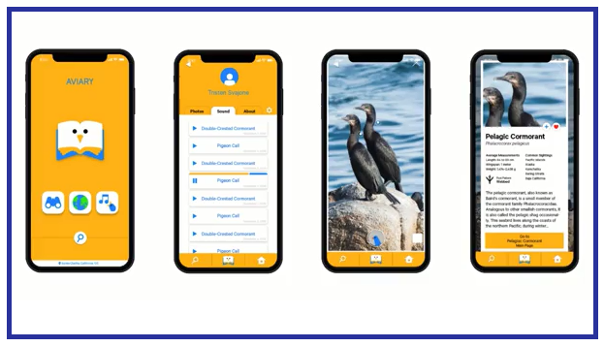
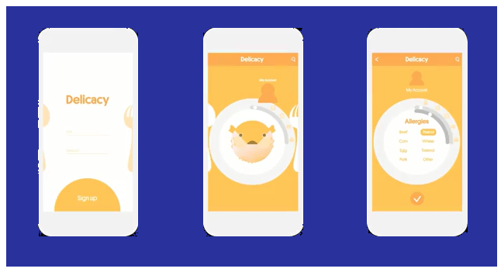
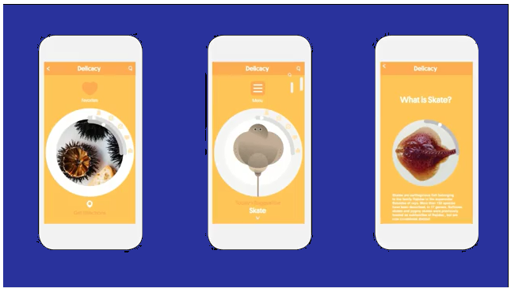
Интерактивті дизайн
Жұмыс жылдамдығы мен дизайн стилі (cont.)
“The best interface is no interface at all”
(G. Krishna)
Notes:
Most design projects have a brief, and a brief outlines or describes the project before you even begin designing. The brief itself is kind of a design project in its own way. So, it's interesting to look at this idea of, "what's in a brief?" A brief often describes what the project is, what its goals are, and how it's going to work. So, this involves looking at content, context, and audience. We need to define...
What is it?
Who is it for?
Where does it live?
Without this clear articulation of these goals, you could be making something for weeks or months without it really achieving what you wanted to achieve. So, let's look at how these three questions might work in a brief and let's look at some examples.
For instance, if we thought about what is it, let's come up with an idea. Perhaps we want to make a dombra tuner, that's something that could be quite interesting to exist on a digital platform. We can also think about who is it for, let's say that it's for beginning dombrists. It's not for master dombrists that might already know how to tune their dombra. It's really for novices - people that are just starting out and might need some help. We could also think about, where does it live? It would be logical for this to live on a phone app, so that it could be possible, it could be easy to carry around and something that we could use hands-free when we’re tuning our dombra. So, when you put these things together, you've got an accurate description, it's a phone app to tune your dombra for beginning dombrists. This is entirely non-visual but we've already started to give some shape to our idea. We've already started to describe it with words and this is pre-design. It's really design that outlines or defines what the project is before you've even made anything.
So, let's try it again. But let's think of a different subject this time. How about an app for students who need chocolate bars or crisps for late-night study breaks. This app will allow you to find a specific food within a given area. It will be the main goal.
Now let’s think about other subject. How about a digital microscope? That sounds like something that could be quite interesting to make as an app and that could utilize a lot of what a phone can do. So, who is it for? In this case, it's going to be for amateur scientists. So again, it's not for the novice but it's also not for the expert. A proven scientist might need something much more technical. Where would it live? It would seem again that this would work as a phone app best of all so it can utilize what a phone is good at. It could use the camera in the phone and it could use the screen of the phone to look at what you're magnifying. If we put these things together, we'd have an accurate description of what the project is, who it's for and where it's going to live? A digital microscope for amateur scientists on your phone. Again, it's purely non-visual. It really just describes the project using words. We've articulated what it is so when we start to make something, we've got a clear set of goals. This is really important to know that our goals, constraints, platform, audience, all of these things are going to shape and inform the design and quite often the designer doesn't get to decide these things. These things are determined by the client. Often, they're determined by the client in the brief, before the designer even gets a chance to think about them or work with them.
So, if you want to be a good designer you're going to need what the goals are? What the constraints are? What kind of platform your project is going to live on? Who the audience is? Because these things will inform your design. What this means is, you really need to know your project, you need to understand every aspect of it so you can make the best possible visual solution for it. More than anything, you need to be the expert no matter what kind of content you're going to be working with. You should be the expert as a designer, but also be the expert in terms of the content that you're working with.

Slide 7
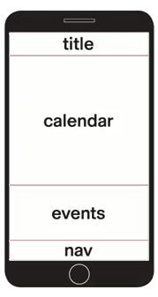
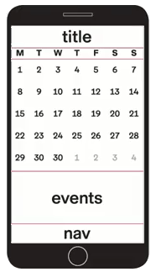
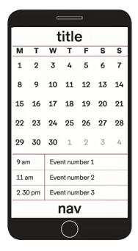
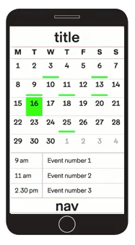
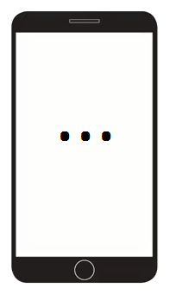
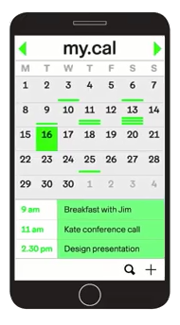
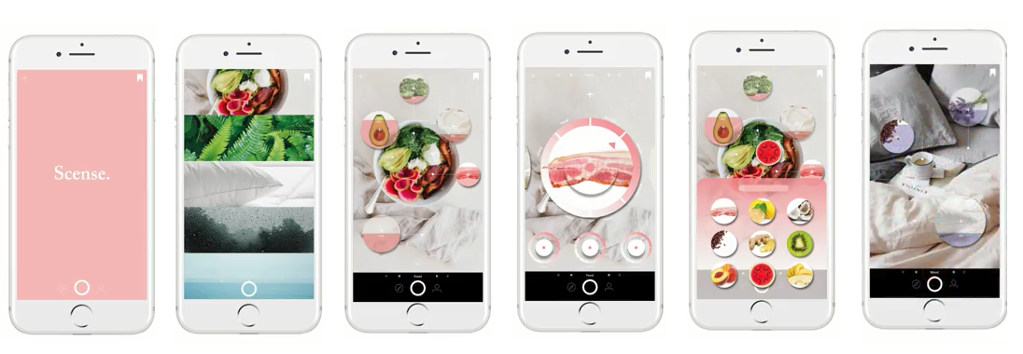
Интерактивті дизайн
Композиция мен құрылым
Мазмұнға бағытталған дизайн 🆚 Контекстке бағытталған дизайн
Қарапайым күнтізбе: функционалдық мазмұн
Иерархия, Түс, Белгілер, Тіл, Пішіндер
Notes:
Most design projects have a brief, and a brief outlines or describes the project before you even begin designing. The brief itself is kind of a design project in its own way. So, it's interesting to look at this idea of, "what's in a brief?" A brief often describes what the project is, what its goals are, and how it's going to work. So, this involves looking at content, context, and audience. We need to define...
What is it?
Who is it for?
Where does it live?
Without this clear articulation of these goals, you could be making something for weeks or months without it really achieving what you wanted to achieve. So, let's look at how these three questions might work in a brief and let's look at some examples.
For instance, if we thought about what is it, let's come up with an idea. Perhaps we want to make a dombra tuner, that's something that could be quite interesting to exist on a digital platform. We can also think about who is it for, let's say that it's for beginning dombrists. It's not for master dombrists that might already know how to tune their dombra. It's really for novices - people that are just starting out and might need some help. We could also think about, where does it live? It would be logical for this to live on a phone app, so that it could be possible, it could be easy to carry around and something that we could use hands-free when we’re tuning our dombra. So, when you put these things together, you've got an accurate description, it's a phone app to tune your dombra for beginning dombrists. This is entirely non-visual but we've already started to give some shape to our idea. We've already started to describe it with words and this is pre-design. It's really design that outlines or defines what the project is before you've even made anything.
So, let's try it again. But let's think of a different subject this time. How about an app for students who need chocolate bars or crisps for late-night study breaks. This app will allow you to find a specific food within a given area. It will be the main goal.
Now let’s think about other subject. How about a digital microscope? That sounds like something that could be quite interesting to make as an app and that could utilize a lot of what a phone can do. So, who is it for? In this case, it's going to be for amateur scientists. So again, it's not for the novice but it's also not for the expert. A proven scientist might need something much more technical. Where would it live? It would seem again that this would work as a phone app best of all so it can utilize what a phone is good at. It could use the camera in the phone and it could use the screen of the phone to look at what you're magnifying. If we put these things together, we'd have an accurate description of what the project is, who it's for and where it's going to live? A digital microscope for amateur scientists on your phone. Again, it's purely non-visual. It really just describes the project using words. We've articulated what it is so when we start to make something, we've got a clear set of goals. This is really important to know that our goals, constraints, platform, audience, all of these things are going to shape and inform the design and quite often the designer doesn't get to decide these things. These things are determined by the client. Often, they're determined by the client in the brief, before the designer even gets a chance to think about them or work with them.
So, if you want to be a good designer you're going to need what the goals are? What the constraints are? What kind of platform your project is going to live on? Who the audience is? Because these things will inform your design. What this means is, you really need to know your project, you need to understand every aspect of it so you can make the best possible visual solution for it. More than anything, you need to be the expert no matter what kind of content you're going to be working with. You should be the expert as a designer, but also be the expert in terms of the content that you're working with.

Slide 8
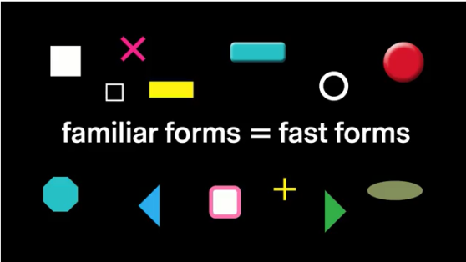
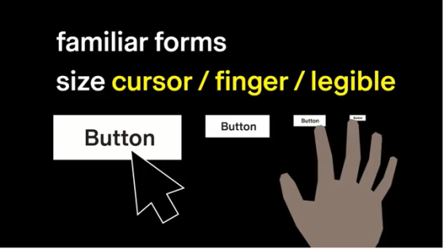
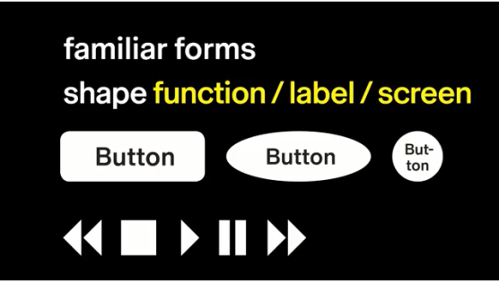
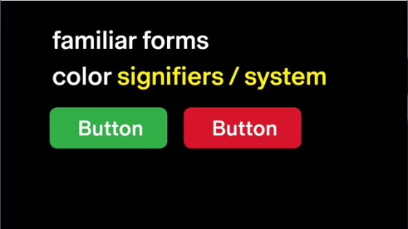
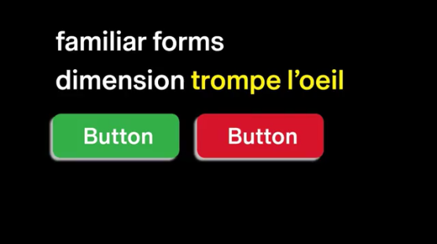
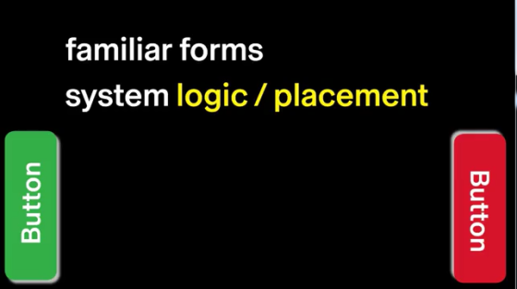
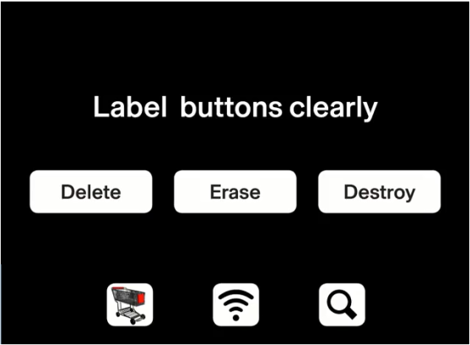
Интерактивті дизайн
Батырма
Таныс пішіндер мен элементтер
  өлшем (cursor/finger/legible)
  пішін (function/label/screen)
  түс (signifiers/system)
  өлшемділік (trompe l’oeil)
  жүйе (logic/placement)
Notes:
Most design projects have a brief, and a brief outlines or describes the project before you even begin designing. The brief itself is kind of a design project in its own way. So, it's interesting to look at this idea of, "what's in a brief?" A brief often describes what the project is, what its goals are, and how it's going to work. So, this involves looking at content, context, and audience. We need to define...
What is it?
Who is it for?
Where does it live?
Without this clear articulation of these goals, you could be making something for weeks or months without it really achieving what you wanted to achieve. So, let's look at how these three questions might work in a brief and let's look at some examples.
For instance, if we thought about what is it, let's come up with an idea. Perhaps we want to make a dombra tuner, that's something that could be quite interesting to exist on a digital platform. We can also think about who is it for, let's say that it's for beginning dombrists. It's not for master dombrists that might already know how to tune their dombra. It's really for novices - people that are just starting out and might need some help. We could also think about, where does it live? It would be logical for this to live on a phone app, so that it could be possible, it could be easy to carry around and something that we could use hands-free when we’re tuning our dombra. So, when you put these things together, you've got an accurate description, it's a phone app to tune your dombra for beginning dombrists. This is entirely non-visual but we've already started to give some shape to our idea. We've already started to describe it with words and this is pre-design. It's really design that outlines or defines what the project is before you've even made anything.
So, let's try it again. But let's think of a different subject this time. How about an app for students who need chocolate bars or crisps for late-night study breaks. This app will allow you to find a specific food within a given area. It will be the main goal.
Now let’s think about other subject. How about a digital microscope? That sounds like something that could be quite interesting to make as an app and that could utilize a lot of what a phone can do. So, who is it for? In this case, it's going to be for amateur scientists. So again, it's not for the novice but it's also not for the expert. A proven scientist might need something much more technical. Where would it live? It would seem again that this would work as a phone app best of all so it can utilize what a phone is good at. It could use the camera in the phone and it could use the screen of the phone to look at what you're magnifying. If we put these things together, we'd have an accurate description of what the project is, who it's for and where it's going to live? A digital microscope for amateur scientists on your phone. Again, it's purely non-visual. It really just describes the project using words. We've articulated what it is so when we start to make something, we've got a clear set of goals. This is really important to know that our goals, constraints, platform, audience, all of these things are going to shape and inform the design and quite often the designer doesn't get to decide these things. These things are determined by the client. Often, they're determined by the client in the brief, before the designer even gets a chance to think about them or work with them.
So, if you want to be a good designer you're going to need what the goals are? What the constraints are? What kind of platform your project is going to live on? Who the audience is? Because these things will inform your design. What this means is, you really need to know your project, you need to understand every aspect of it so you can make the best possible visual solution for it. More than anything, you need to be the expert no matter what kind of content you're going to be working with. You should be the expert as a designer, but also be the expert in terms of the content that you're working with.

Slide 9
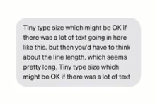




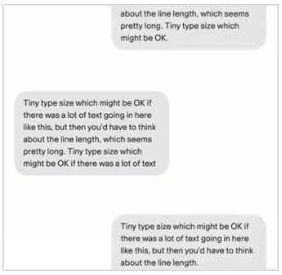
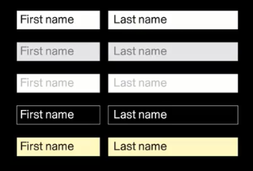





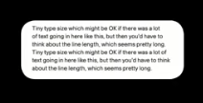
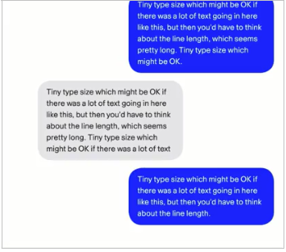
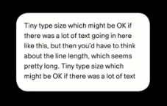
Интерактивті дизайн
Батырма емес элементтер
ЖЫЛДАМДЫҚ / ФУНКЦИОНАЛДЫҚ
Пішін
Масштаб
Контраст
Айқындық
Үнемділік
Notes:
Most design projects have a brief, and a brief outlines or describes the project before you even begin designing. The brief itself is kind of a design project in its own way. So, it's interesting to look at this idea of, "what's in a brief?" A brief often describes what the project is, what its goals are, and how it's going to work. So, this involves looking at content, context, and audience. We need to define...
What is it?
Who is it for?
Where does it live?
Without this clear articulation of these goals, you could be making something for weeks or months without it really achieving what you wanted to achieve. So, let's look at how these three questions might work in a brief and let's look at some examples.
For instance, if we thought about what is it, let's come up with an idea. Perhaps we want to make a dombra tuner, that's something that could be quite interesting to exist on a digital platform. We can also think about who is it for, let's say that it's for beginning dombrists. It's not for master dombrists that might already know how to tune their dombra. It's really for novices - people that are just starting out and might need some help. We could also think about, where does it live? It would be logical for this to live on a phone app, so that it could be possible, it could be easy to carry around and something that we could use hands-free when we’re tuning our dombra. So, when you put these things together, you've got an accurate description, it's a phone app to tune your dombra for beginning dombrists. This is entirely non-visual but we've already started to give some shape to our idea. We've already started to describe it with words and this is pre-design. It's really design that outlines or defines what the project is before you've even made anything.
So, let's try it again. But let's think of a different subject this time. How about an app for students who need chocolate bars or crisps for late-night study breaks. This app will allow you to find a specific food within a given area. It will be the main goal.
Now let’s think about other subject. How about a digital microscope? That sounds like something that could be quite interesting to make as an app and that could utilize a lot of what a phone can do. So, who is it for? In this case, it's going to be for amateur scientists. So again, it's not for the novice but it's also not for the expert. A proven scientist might need something much more technical. Where would it live? It would seem again that this would work as a phone app best of all so it can utilize what a phone is good at. It could use the camera in the phone and it could use the screen of the phone to look at what you're magnifying. If we put these things together, we'd have an accurate description of what the project is, who it's for and where it's going to live? A digital microscope for amateur scientists on your phone. Again, it's purely non-visual. It really just describes the project using words. We've articulated what it is so when we start to make something, we've got a clear set of goals. This is really important to know that our goals, constraints, platform, audience, all of these things are going to shape and inform the design and quite often the designer doesn't get to decide these things. These things are determined by the client. Often, they're determined by the client in the brief, before the designer even gets a chance to think about them or work with them.
So, if you want to be a good designer you're going to need what the goals are? What the constraints are? What kind of platform your project is going to live on? Who the audience is? Because these things will inform your design. What this means is, you really need to know your project, you need to understand every aspect of it so you can make the best possible visual solution for it. More than anything, you need to be the expert no matter what kind of content you're going to be working with. You should be the expert as a designer, but also be the expert in terms of the content that you're working with.

Slide 10
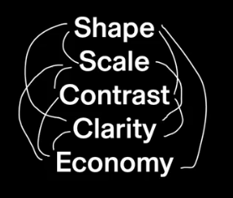


Интерактивті дизайн
Батырма емес элементтер
(cont.)
  LINKS: The simplest way to show a link
MENUS
  Drop down type list
  Highlighted choices
  Nested subcategories
  Activity /visibility
  Economical
  Known location
  Spatial economy
  Need-to-know
Shape of box
Scale of box
Color of box
Relationship to main menu
Relationship to elements
Typeface
Weight/Size
Leading/Case
Color of Type
State change
Notes:
Most design projects have a brief, and a brief outlines or describes the project before you even begin designing. The brief itself is kind of a design project in its own way. So, it's interesting to look at this idea of, "what's in a brief?" A brief often describes what the project is, what its goals are, and how it's going to work. So, this involves looking at content, context, and audience. We need to define...
What is it?
Who is it for?
Where does it live?
Without this clear articulation of these goals, you could be making something for weeks or months without it really achieving what you wanted to achieve. So, let's look at how these three questions might work in a brief and let's look at some examples.
For instance, if we thought about what is it, let's come up with an idea. Perhaps we want to make a dombra tuner, that's something that could be quite interesting to exist on a digital platform. We can also think about who is it for, let's say that it's for beginning dombrists. It's not for master dombrists that might already know how to tune their dombra. It's really for novices - people that are just starting out and might need some help. We could also think about, where does it live? It would be logical for this to live on a phone app, so that it could be possible, it could be easy to carry around and something that we could use hands-free when we’re tuning our dombra. So, when you put these things together, you've got an accurate description, it's a phone app to tune your dombra for beginning dombrists. This is entirely non-visual but we've already started to give some shape to our idea. We've already started to describe it with words and this is pre-design. It's really design that outlines or defines what the project is before you've even made anything.
So, let's try it again. But let's think of a different subject this time. How about an app for students who need chocolate bars or crisps for late-night study breaks. This app will allow you to find a specific food within a given area. It will be the main goal.
Now let’s think about other subject. How about a digital microscope? That sounds like something that could be quite interesting to make as an app and that could utilize a lot of what a phone can do. So, who is it for? In this case, it's going to be for amateur scientists. So again, it's not for the novice but it's also not for the expert. A proven scientist might need something much more technical. Where would it live? It would seem again that this would work as a phone app best of all so it can utilize what a phone is good at. It could use the camera in the phone and it could use the screen of the phone to look at what you're magnifying. If we put these things together, we'd have an accurate description of what the project is, who it's for and where it's going to live? A digital microscope for amateur scientists on your phone. Again, it's purely non-visual. It really just describes the project using words. We've articulated what it is so when we start to make something, we've got a clear set of goals. This is really important to know that our goals, constraints, platform, audience, all of these things are going to shape and inform the design and quite often the designer doesn't get to decide these things. These things are determined by the client. Often, they're determined by the client in the brief, before the designer even gets a chance to think about them or work with them.
So, if you want to be a good designer you're going to need what the goals are? What the constraints are? What kind of platform your project is going to live on? Who the audience is? Because these things will inform your design. What this means is, you really need to know your project, you need to understand every aspect of it so you can make the best possible visual solution for it. More than anything, you need to be the expert no matter what kind of content you're going to be working with. You should be the expert as a designer, but also be the expert in terms of the content that you're working with.

Slide 11




Интерактивті дизайн
Күйлер мен Өзгерістер
Батырма: визуалды белгілер мен күй өзгерістері
Қалыпты күй
Үстіне
апарылған
күй
Басылған күй
Өшірулі күй
Тану
Растау
Белсендіру
Бас тарту
Normal
Hover
Press
Inactive
Notes:
Most design projects have a brief, and a brief outlines or describes the project before you even begin designing. The brief itself is kind of a design project in its own way. So, it's interesting to look at this idea of, "what's in a brief?" A brief often describes what the project is, what its goals are, and how it's going to work. So, this involves looking at content, context, and audience. We need to define...
What is it?
Who is it for?
Where does it live?
Without this clear articulation of these goals, you could be making something for weeks or months without it really achieving what you wanted to achieve. So, let's look at how these three questions might work in a brief and let's look at some examples.
For instance, if we thought about what is it, let's come up with an idea. Perhaps we want to make a dombra tuner, that's something that could be quite interesting to exist on a digital platform. We can also think about who is it for, let's say that it's for beginning dombrists. It's not for master dombrists that might already know how to tune their dombra. It's really for novices - people that are just starting out and might need some help. We could also think about, where does it live? It would be logical for this to live on a phone app, so that it could be possible, it could be easy to carry around and something that we could use hands-free when we’re tuning our dombra. So, when you put these things together, you've got an accurate description, it's a phone app to tune your dombra for beginning dombrists. This is entirely non-visual but we've already started to give some shape to our idea. We've already started to describe it with words and this is pre-design. It's really design that outlines or defines what the project is before you've even made anything.
So, let's try it again. But let's think of a different subject this time. How about an app for students who need chocolate bars or crisps for late-night study breaks. This app will allow you to find a specific food within a given area. It will be the main goal.
Now let’s think about other subject. How about a digital microscope? That sounds like something that could be quite interesting to make as an app and that could utilize a lot of what a phone can do. So, who is it for? In this case, it's going to be for amateur scientists. So again, it's not for the novice but it's also not for the expert. A proven scientist might need something much more technical. Where would it live? It would seem again that this would work as a phone app best of all so it can utilize what a phone is good at. It could use the camera in the phone and it could use the screen of the phone to look at what you're magnifying. If we put these things together, we'd have an accurate description of what the project is, who it's for and where it's going to live? A digital microscope for amateur scientists on your phone. Again, it's purely non-visual. It really just describes the project using words. We've articulated what it is so when we start to make something, we've got a clear set of goals. This is really important to know that our goals, constraints, platform, audience, all of these things are going to shape and inform the design and quite often the designer doesn't get to decide these things. These things are determined by the client. Often, they're determined by the client in the brief, before the designer even gets a chance to think about them or work with them.
So, if you want to be a good designer you're going to need what the goals are? What the constraints are? What kind of platform your project is going to live on? Who the audience is? Because these things will inform your design. What this means is, you really need to know your project, you need to understand every aspect of it so you can make the best possible visual solution for it. More than anything, you need to be the expert no matter what kind of content you're going to be working with. You should be the expert as a designer, but also be the expert in terms of the content that you're working with.

Slide 12


Интерактивті дизайн
Күйлер мен Өзгерістер (cont.)
Қозғалыс күйлері дәстүрлі күй ауысуларын алмастырады
The Swipe
Replaces
The Click
The Finger
Replaces
The Mouse
Элементтердің әртүрлі СТАТИКАЛЫҚ күйлерін және олардың күйлер арасындағы АНИМАЦИЯСЫН ойлаңыз
Notes:
Most design projects have a brief, and a brief outlines or describes the project before you even begin designing. The brief itself is kind of a design project in its own way. So, it's interesting to look at this idea of, "what's in a brief?" A brief often describes what the project is, what its goals are, and how it's going to work. So, this involves looking at content, context, and audience. We need to define...
What is it?
Who is it for?
Where does it live?
Without this clear articulation of these goals, you could be making something for weeks or months without it really achieving what you wanted to achieve. So, let's look at how these three questions might work in a brief and let's look at some examples.
For instance, if we thought about what is it, let's come up with an idea. Perhaps we want to make a dombra tuner, that's something that could be quite interesting to exist on a digital platform. We can also think about who is it for, let's say that it's for beginning dombrists. It's not for master dombrists that might already know how to tune their dombra. It's really for novices - people that are just starting out and might need some help. We could also think about, where does it live? It would be logical for this to live on a phone app, so that it could be possible, it could be easy to carry around and something that we could use hands-free when we’re tuning our dombra. So, when you put these things together, you've got an accurate description, it's a phone app to tune your dombra for beginning dombrists. This is entirely non-visual but we've already started to give some shape to our idea. We've already started to describe it with words and this is pre-design. It's really design that outlines or defines what the project is before you've even made anything.
So, let's try it again. But let's think of a different subject this time. How about an app for students who need chocolate bars or crisps for late-night study breaks. This app will allow you to find a specific food within a given area. It will be the main goal.
Now let’s think about other subject. How about a digital microscope? That sounds like something that could be quite interesting to make as an app and that could utilize a lot of what a phone can do. So, who is it for? In this case, it's going to be for amateur scientists. So again, it's not for the novice but it's also not for the expert. A proven scientist might need something much more technical. Where would it live? It would seem again that this would work as a phone app best of all so it can utilize what a phone is good at. It could use the camera in the phone and it could use the screen of the phone to look at what you're magnifying. If we put these things together, we'd have an accurate description of what the project is, who it's for and where it's going to live? A digital microscope for amateur scientists on your phone. Again, it's purely non-visual. It really just describes the project using words. We've articulated what it is so when we start to make something, we've got a clear set of goals. This is really important to know that our goals, constraints, platform, audience, all of these things are going to shape and inform the design and quite often the designer doesn't get to decide these things. These things are determined by the client. Often, they're determined by the client in the brief, before the designer even gets a chance to think about them or work with them.
So, if you want to be a good designer you're going to need what the goals are? What the constraints are? What kind of platform your project is going to live on? Who the audience is? Because these things will inform your design. What this means is, you really need to know your project, you need to understand every aspect of it so you can make the best possible visual solution for it. More than anything, you need to be the expert no matter what kind of content you're going to be working with. You should be the expert as a designer, but also be the expert in terms of the content that you're working with.

Slide 13

Интерактивті дизайн
Назарларыңызға рахмет!

