Slide 1
Введение в практикум по экстрактивной металлургии
Introduction to extractive metallurgy practice unit
М И Н И С Т Е Р С Т В О О Б Р А З О В А Н И Я И Н А У К И Р Е С П У Б Л И К И К А З А Х С Т А Н
SATBAYEV UNIVERSITY
Металлургические процессы, теплотехника и технологии специальных материалов
(кафедра)
Специальные главы металлургической инженерии
(дисциплина)
Практическое занятие № 1
1 академический час

Slide 2
Practical Lesson #1.
Mixtures – Solutions – Phases
Almost all materials have more than one phase in them.
Thus engineering materials attain their special properties.
Macroscopic basic unit of a material is called component. It refers to a independent chemical species. The components of a system may be elements, ions or compounds.
A phase can be defined as a homogeneous portion of a system that has uniform physical and chemical characteristics, i.e. it is a physically distinct from other phases, chemically homogeneous and mechanically separable portion of a system.
A component can exist in many phases.
E.g.: Water exists as ice, liquid water, and water vapor. Carbon exists as graphite and diamond.
Mixtures – Solutions – Phases _{(contd…)}
When two phases are present in a system, it is not necessary that there be a difference in both physical and chemical properties; a disparity in one or the other set of properties is sufficient.
A solution (liquid or solid) is phase with more than one component; a mixture is a material with more than one phase.
Solute (minor component of two in a solution) does not change the structural pattern of the solvent, and the composition of any solution can be varied.
In mixtures, there are different phases, each with its own atomic arrangement. It is possible to have a mixture of two different solutions!

Slide 3
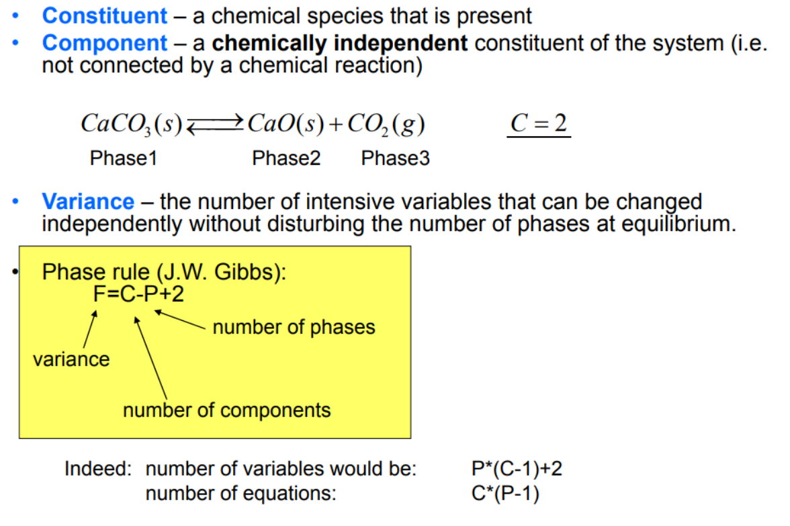
Example

Slide 4
Equilibrium phase diagram
A diagram that depicts existence of different phases of a system under equilibrium is termed as phase diagram.
It is actually a collection of solubility limit curves. It is also known as equilibrium or constitutional diagram.
Equilibrium phase diagrams represent the relationships between temperature, compositions and the quantities of phases at equilibrium.
These diagrams do not indicate the dynamics when one phase transforms into another.
Useful terminology related to phase diagrams: liquidus, solidus, solvus, terminal solid solution, invariant reaction, intermediate solid solution, inter-metallic compound, etc.
Phase diagrams are classified according to the number of component present in a particular system.

Slide 5
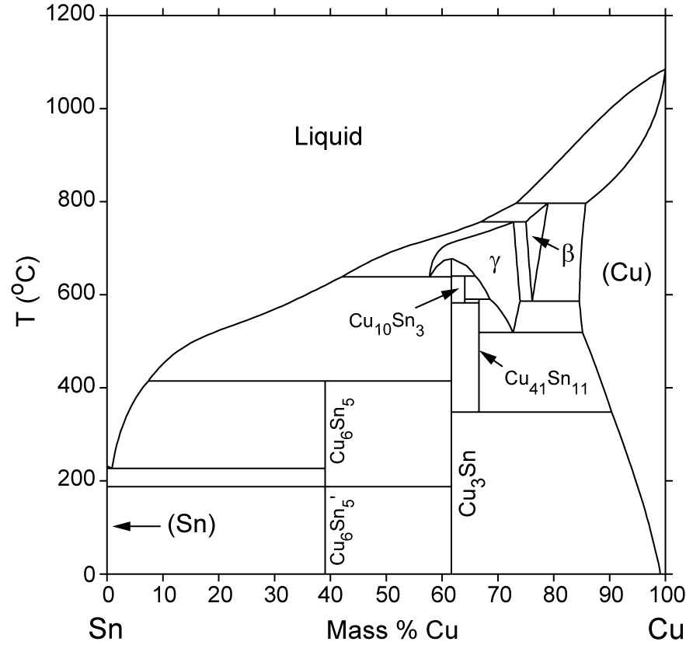
Phase diagram – Useful information
Important information, useful in materials development and selection, obtainable from a phase diagram:
It shows phases present at different compositions and temperatures under slow cooling (equilibrium) conditions.
It indicates equilibrium solid solubility of one element/compound in another.
It suggests temperature at which an alloy starts to solidify and the range of solidification.
It signals the temperature at which different phases start to melt.
Amount of each phase in a two-phase mixture can be obtained.

Slide 6
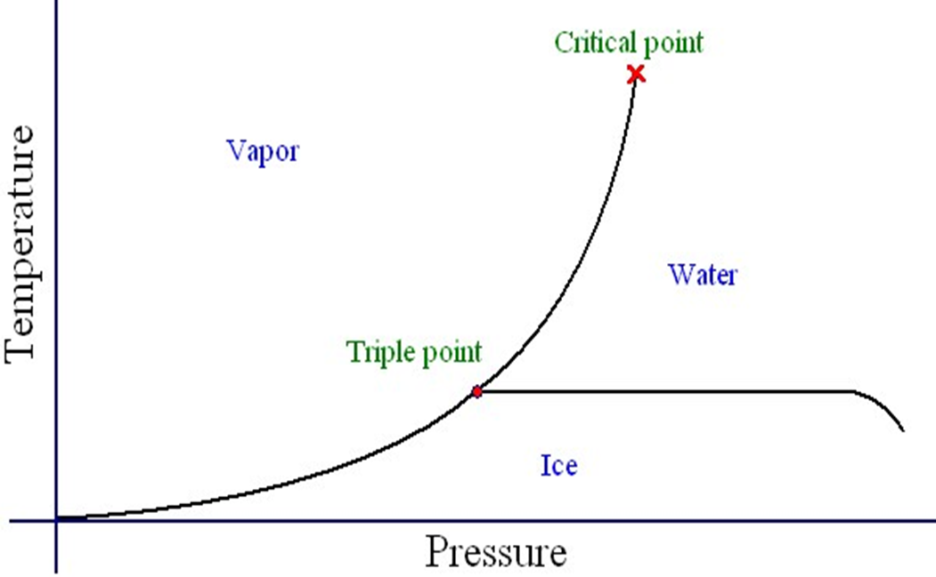
Unary phase diagram
If a system consists of just one component (e.g.: water), equilibrium of phases exist is depicted by unary phase diagram. The component may exist in different forms, thus variables here are – temperature and pressure.

Slide 7
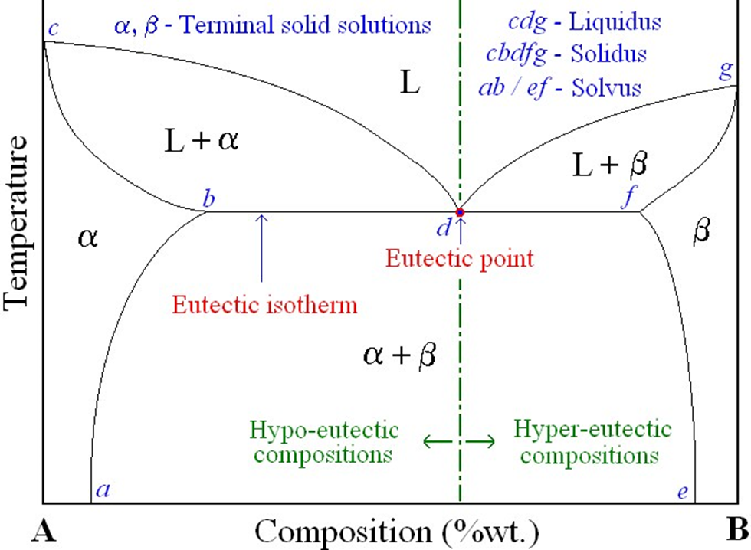
Eutectic binary system
Ø Many of the binary systems with limited solubility are of eutectic type – eutectic alloy of eutectic composition solidifies at the end of solidification at eutectic temperature.
E.g.: Cu-Ag, Pb-Sn

Slide 8
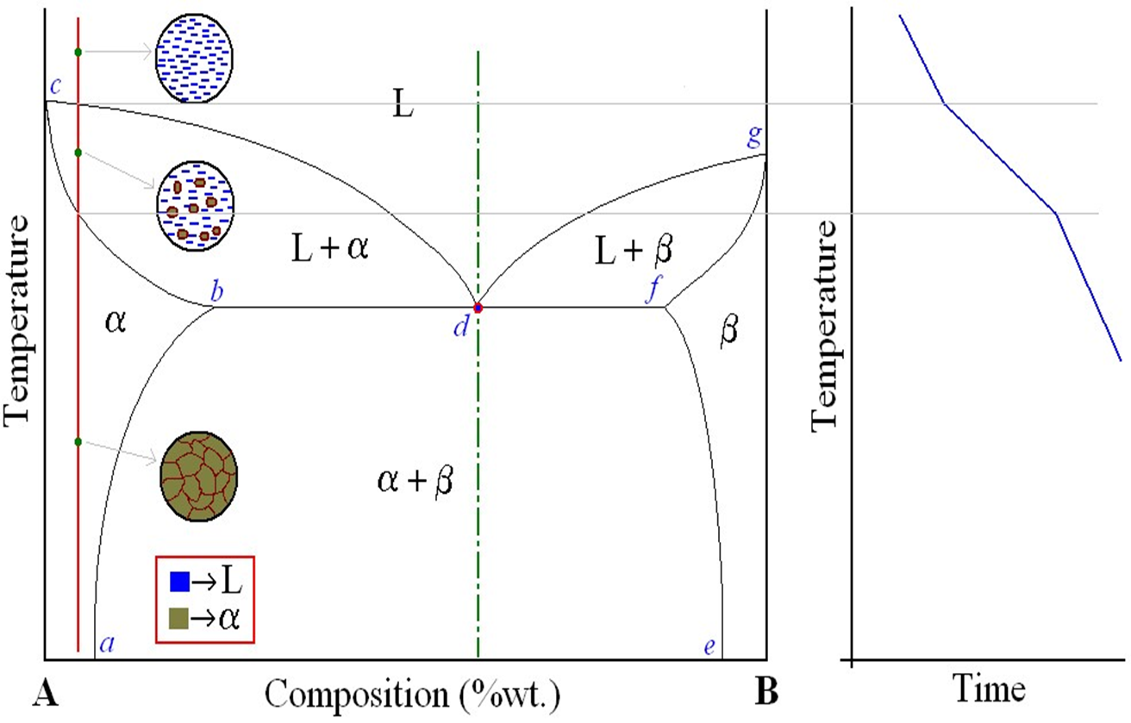
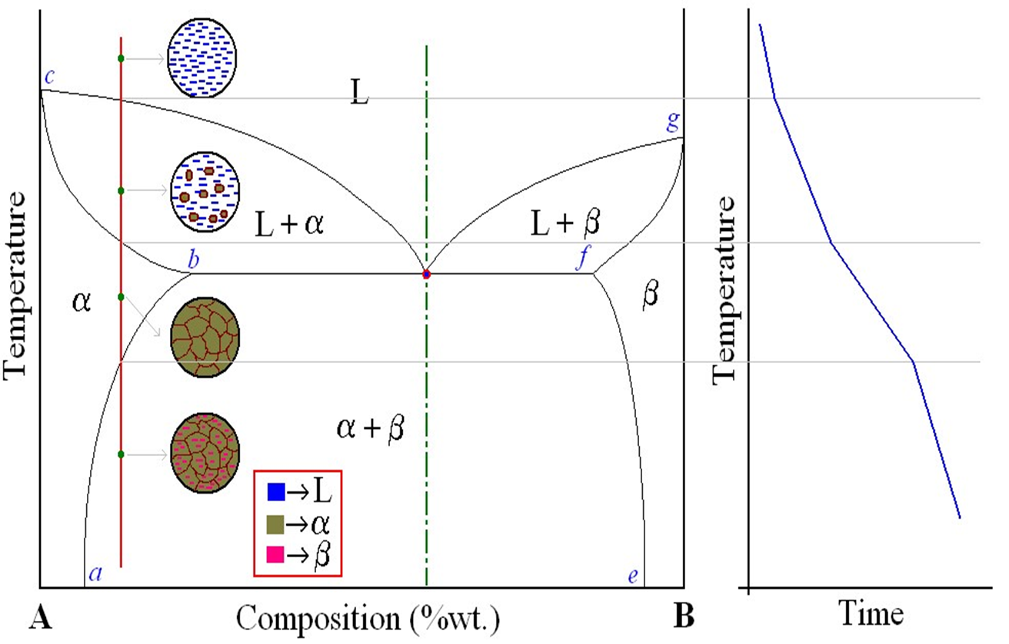
Eutectic system – Cooling curve – Microstructure (contd….)
Eutectic system – Cooling curve – Microstructure
(contd….)

Slide 9
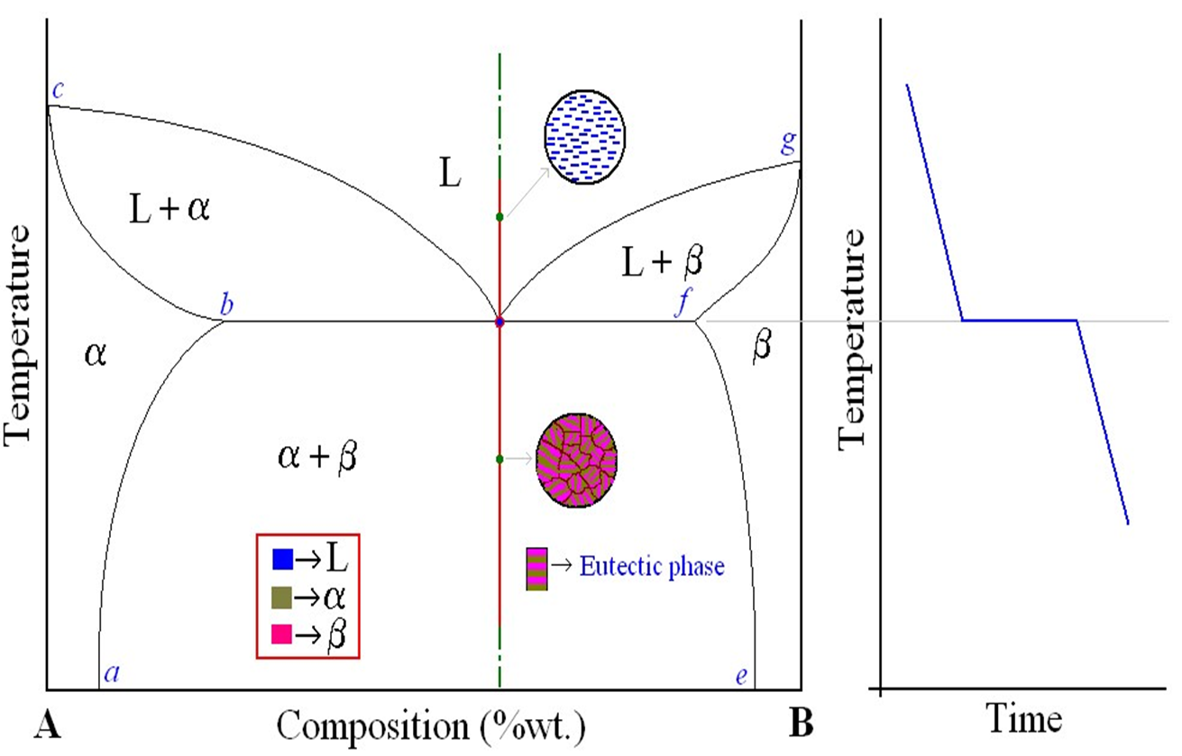
Eutectic system – Cooling curve – Microstructure
(contd….)

Slide 10
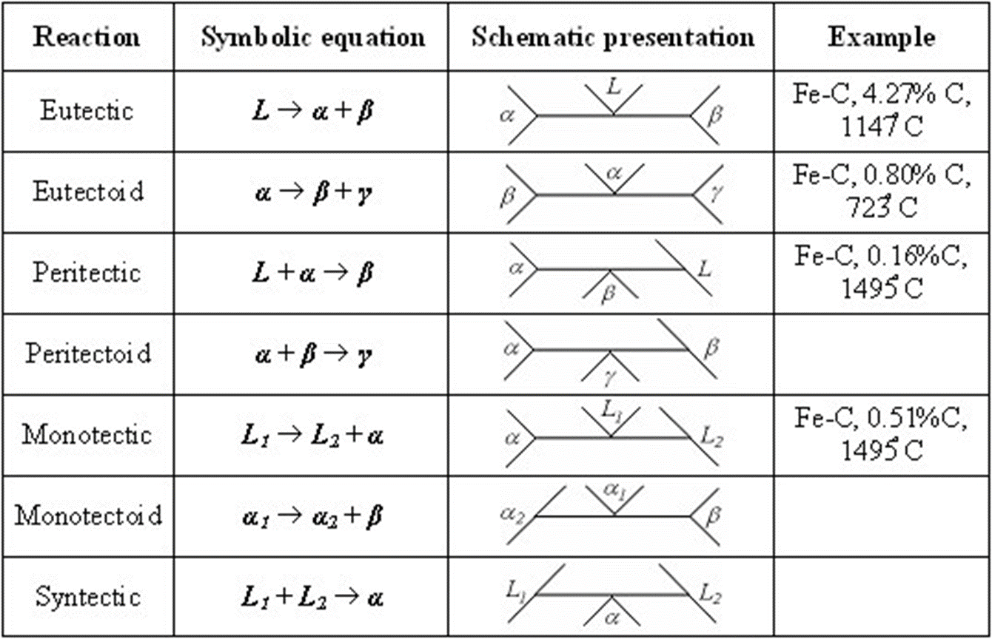
Invariant reactions (contd….)

Slide 12
Congruent, Incongruent transformations
Phase transformations are two kinds – congruent and incongruent.
Congruent transformation involves no compositional changes. It usually occurs at a temperature.
  g.: Allotropic transformations, melting of pure a substance.
During incongruent transformations, at least one phase will undergo compositional change.
  g.: All invariant reactions, melting of isomorphous alloy.
Intermediate phases are sometimes classified on the basis of whether they melt congruently or incongruently.
  g.: MgNi2, for example, melts congruently whereas Mg2Ni melts incongruently since it undergoes peritectic decomposition.
Precipitation – Strengthening – Reactions
A material can be strengthened by obstructing movement of dislocations. Second phase particles are effective.
Second phase particles are introduced mainly by two means – direct mixing and consolidation, or by precipitation.
Most important pre-requisite for precipitation strengthening: there must be a terminal solid solution which has a decreasing solid solubility as the temperature decreases.
E.g.: Au-Cu in which maximum solid solubility of Cu in Al is 5.65% at 548 C that decreases with decreasing temperature.
Three basic steps in precipitation strengthening: solutionizing, quenching and aging.

Slide 13
Solutionizing (solution heat treatment), where the alloy is heated to a temperature between solvus and solidus temperatures and kept there till a uniform solid-solution structure is produced.
'солюционирование'-вид термообработки, проводимой чуть ниже ликвидуса с целью гомогенизации материала. Детали становятся более пластичными
Quenching, where the sample is rapidly cooled to a lower temperature (room temperature).
Resultant product – supersaturated solid solution.
Aging is the last but critical step. During this heat treatment step finely dispersed precipitate particle will form. Aging the alloy at room temperature is called natural aging, whereas at elevated temperatures is called artificial aging. Most alloys require artificial aging, and aging temperature is usually between 15-25% of temperature difference between room temperature and solution heat treatment temperature.

Slide 14
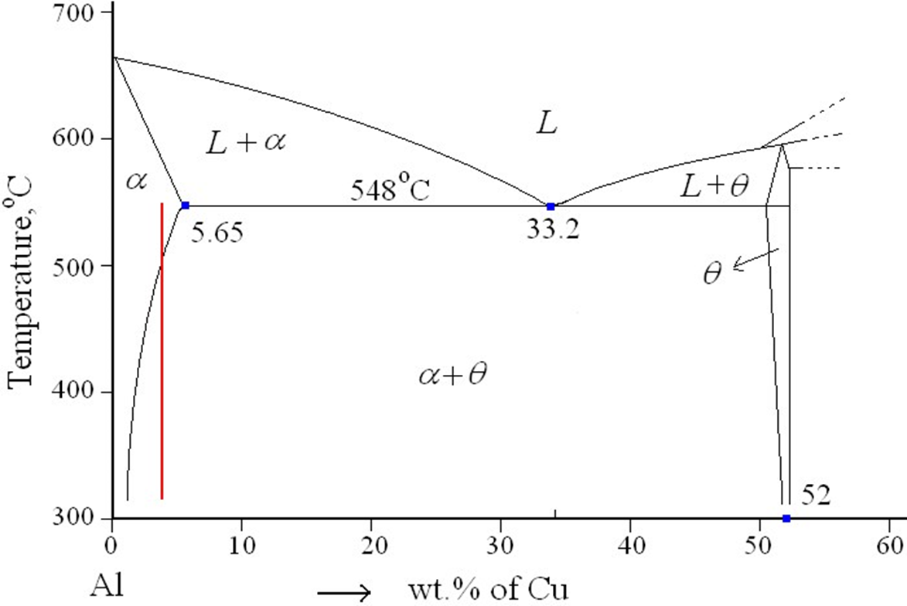
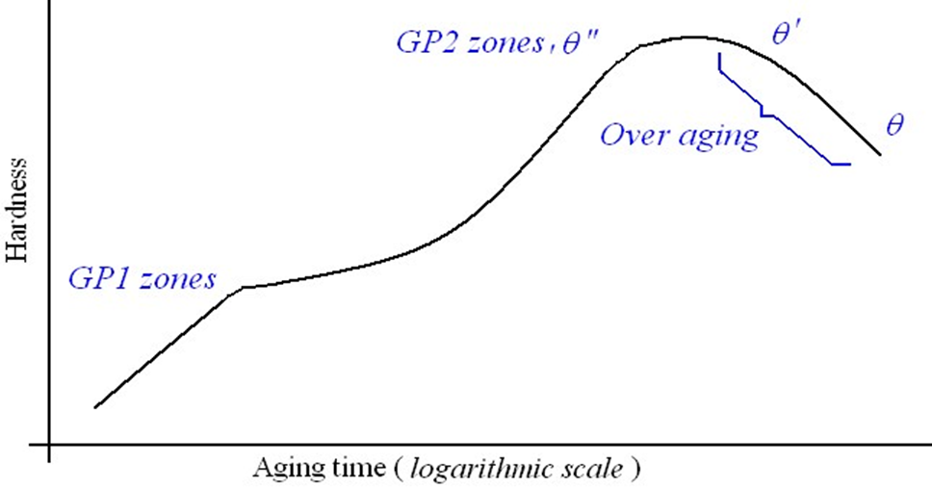
Precipitation – Strengthening – Reactions _{(contd….)}
Al-4%Cu alloy when cooled slowly from solutionizing temperature, produces coarse grains (крупное зерно)– moderate strengthening.
For precipitation strengthening, it is quenched, and aged!
Following sequential reactions takes place during aging:
Supersaturated α → GP1 zones → GP2 zones (θ” phase) → θ’ phase → θ phase (CuAl2)
Al-4%Cu alloy when cooled slowly from solutionizing temperature, produces coarse grains – moderate strengthening.
For precipitation strengthening, it is quenched, and aged!
Following sequential reactions takes place during aging:
Supersaturated α → GP1 zones → GP2 zones (θ” phase) → θ’ phase → θ phase (CuAl₂)

Slide 15
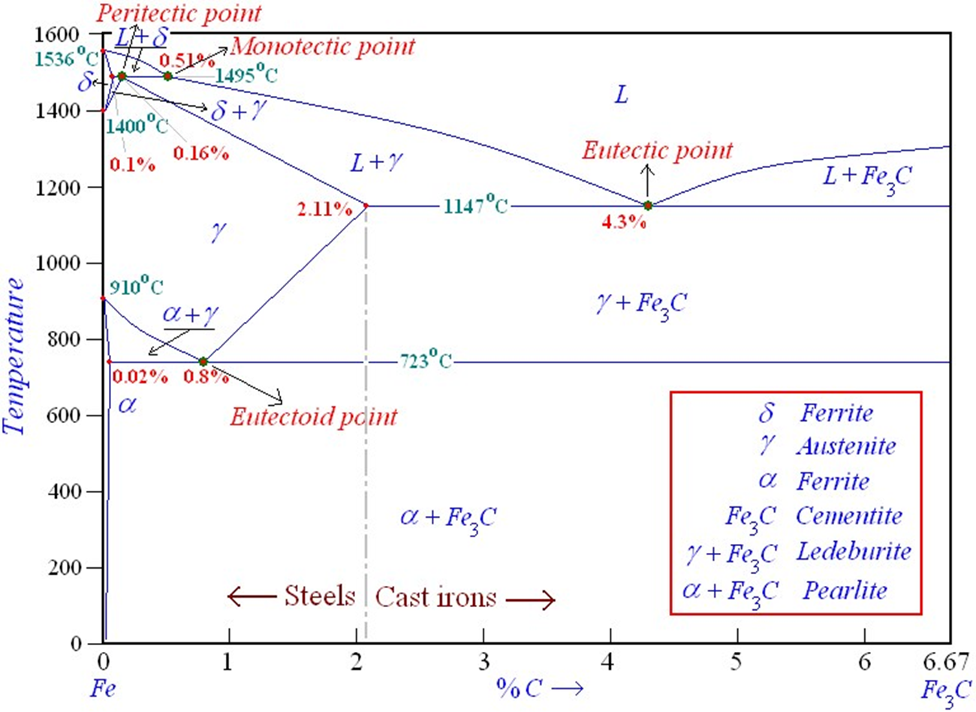
Fe-C binary system – Phase transformations

Slide 16
Exercise
1) Draw a melting diagram of the A - B system, if known:
• A and B are infinitely soluble in the liquid state;
• melting point of A 790 K;
• melting point of B 630 K;
• at a temperature of 420 K there is an invariant transformation, the composition of the liquid phase in the invariant transformation xA = 0.35;
• the minimum solubility of the components in the solid state is: A in B -xA = 0.1; ВвА-хb = 0.05;
• maximum solubility of components in solid state: A in B-xA = 0.2; B in A -xb = 0.15.

Slide 17
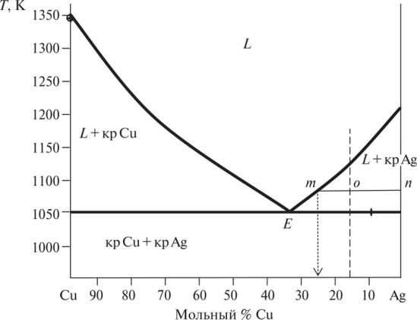
Exercise 2
What component and in what amount will crystallize out if 5 kg of the melt containing 85 mol% Ag (the fusibility diagram is shown in ) is cooled to 1070K?
Fig.12 Cu-Ag state diagram

