Slide 1
Practical lesson #7

Slide 2
SMELTING
Thermal reduction processes – reduction smelting
Reduction smelting is usually used to produce metals from raw oxide materials – e.g. production of Fe, Sn, W, Ta, Nb, Mn, Cr and other metals. To produce metals from raw sulphidic materials, e.g. production of Pb from galena, Zn from zinc blende, Mo from molybdenite, etc., the sulphidic raw material has to firstly be roasted by oxidizing to produce oxides, which are subsequently reduced to metals. Halides and many other metal compounds can be reduced as well.
As reducing agents, H2, CO, CH4, products of natural gas or coal distillation dissociation, solid carbon, calcium carbide and various metals with higher electronegativities than of the reduced metals are usually used. The basic equations of oxides reductions can generally be expressed as:
MeO + RO(g)=Me + RO2
MeO + R(s)=Me + RO
where RO are reducing agents, i.e. all the agents able to dissociate oxygen from an oxide.

Slide 3
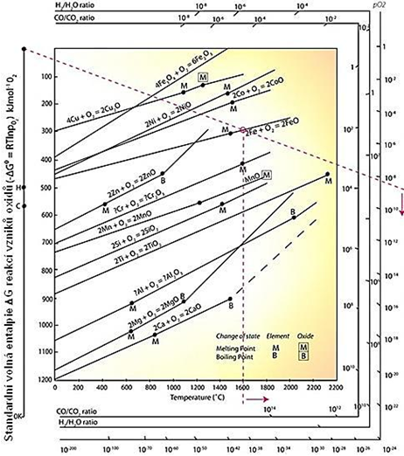
Chemical reduction of metals
Reduction of metals is performed using reducing agents, which have higher affinities to oxygen than the reduced metals. Abilities of compounds to bind oxygen can be evaluated using values of Gibbs energies ( G) for generation of oxides at various temperatures. Temperature dependences of changes of the Gibbs free energies of reactions to produce oxides of individual elements are depicted in Ellingham–Richardson diagrams (Fig. 2).
The more negative the value of Gibbs free energy change G is, the more stable is the oxide (CaO, MgO, Al2O3).
The lines for individual metals and their components change their directions at temperatures of melting TM, boiling TB and sublimation TS. From the almost parallel character of changes of the Gibbs free energies with temperature for the individual metals during bonding ensues that metals can be reduced by different metals from their compounds of a same kind in a certain order.
A metal with a lower (more negative) Gibbs free energy can reduce a metal with a higher Gibbs free energy. If a metal forms several oxides, the lowest oxides are always the most stable, e.g. (Fe) FeO Fe3O4 Fe2O3. Therefore, higher metal oxides are reduced more easily than lower metal oxides

Slide 4
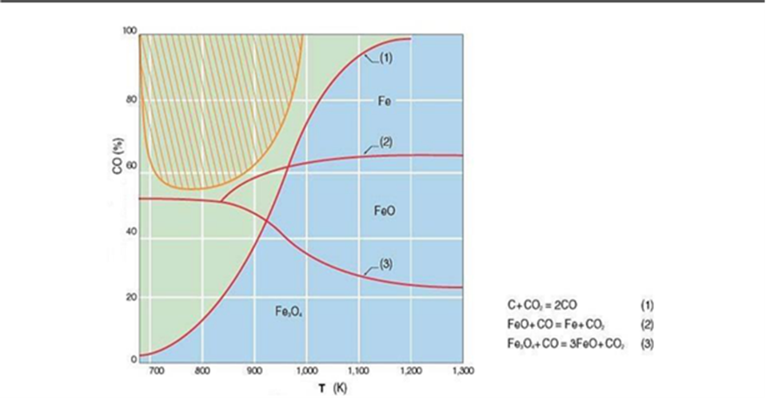
Reduction of metal oxides by carbon

Slide 5
Example 1
Given: What weight of carbon should be mixed with 1000 g of potassium perchlorate in order that the products of the reaction be KCl and CO₂?
Solution: Taking the equation for the reaction as KClO₄ +2 C = KCl + CO_{2 (g)}
We first calculate the formula weight of KClO₄ - M (KClO₄) = 39,1+35,5+16*4=138.6
According the reaction KClO₄ +2 C = KCl + CO₂
138,6 KClO₄– 2*12 C
1000 g KClO₄ – x g C x = 24*1000/138,6 = 173 g C
Hence about 173 g of carbon is required for 1000 g of potassium perchlorate
Problem for solving yourself
How much coal (assumed that coal consist 7 % impurities) is needed to reduce m (one ton) of ZnO to zink? How much zink is produced?
# | 1 | 2 | 3 | 4 | 5 | 6 | 7 | 8 | 9
C,% impurities | 3 | 4 | 5 | 6 | 8 | 9 | 10 | 11 | 12
m(Fe₂O₃₎, t | 0,9 | 0,8 | 0,9 | 1,1 | 1,2 | 1,3 | 1,4 | 1,5 | 1,2

Slide 6
EXAMPLE 2
Solve the task yourself. Problem 2.
Determine the temperatures at which copper oxide can dissociate under (i) standart conditions (ii) a pressure of 10⁻³ mm Hg given,
4Cu + O₂ = 2Cu₂O ΔG⁰_{Cu2O} = - 337038 + 142,6Т KJ/M

Slide 7
Example 3.
The standard free energy for change for the reaction: NiO(s) + CO(g) = Ni(s) + CO₂(g) at 1125 K is −5147 cal.
Would an atmosphere of 15% CO₂, 5% CO and 80% N₂ oxidize nickel at 1125 K?
Do itself:
The standard free energy for change for the reaction:
NiO(s) + CO(g) = Ni(s) + CO₂(g)
at 1125 K is −5147 cal.
Would an atmosphere of 15% CO₂, 5% CO and 80% N₂ oxidize
nickel at 1125 K?
# | 1 | 2 | 3 | 4 | 5 | 6 | 7 | 8 | 9
w% CO₂ | 13 | 14 | 15 | 20 | 19 | 16 | 17 | 14 | 14
w% CO | 8 | 9 | 8 | 10 | 12 | 11 | 12 | 14 | 16
w% N₂ | 79 | 77 | 77 | 70 | 69 | 73 | 71 | 72 | 70

