Slide 1
Metallurgical engineering MET4331
3 credits
Ph.D, Assistant Professor Mamyrbayeva Kulzira Kaldybekovna

Slide 2
Lecture 8 Hydrometallurgy
Hydrometallurgy
The main stages of hydrometallurgy
Leaching agents
Leaching methods

Slide 3
Hydrometallurgy - extraction, recovery and purification of metals, through processes in aqueous solutions. Metals are also recovered in the other forms such as oxides, hydroxides [haɪdrɒksaɪd].
Hydrometallurgy includes processes of production of metals from ores, concentrates, semi-products and wastes by applications of aqueous solutions of chemical agents resulting in subsequent separation of metals or their chemical compounds from the solutions. It is used to produce various metals, including Zn, Au and platinum metals, Cu, Ni, Co, Al (Al2O3), U, W, Mo, Ta, V, rare earth metals and other precious metals. The basic steps of hydrometallurgical metals production are schematically depicted in Fig. 3.1.
Hydrometallurgical processing may be used for the following purposes:
Production of pure solutions from which high purity metals can be produced by electrolysis, e.g., copper, zinc, nickel, gold, and silver.
Production of pure compounds, which can be subsequently used for producing the pure metals by other methods. For example, pure alumina to produce smelter grade aluminium.
However, hydrometallurgy principles can be applied to a variety of areas such as metals recycling from scrap, slag, sludge, anode slime, waste processing, etc..

Slide 4
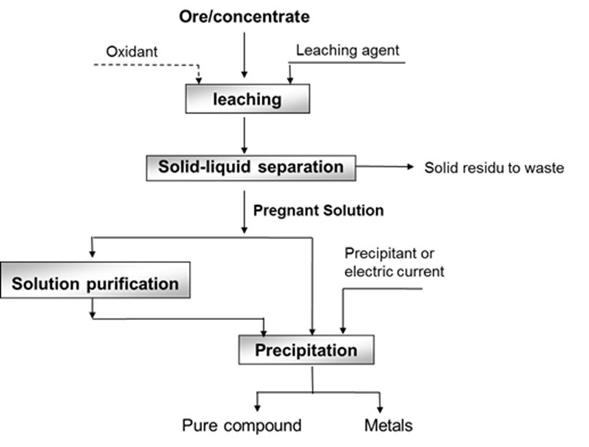
In general, hydrometallurgy involves 2 (two) main steps:
1) Leaching
Selective dissolution of valuable metals from ore.
2) Recovery
Selective precipitation of the desired metals from a pregnant-leach solution (PLS).
Recovery

Slide 5
Reagents in hydrometallurgicall processes
The mostly applied leaching agents are:
Water – for leaching of calcines after sulphate or chloride roasting, e.g. leaching of Re₂O₇.
Aqueous solutions of salts:
Fe₂(SO₄)₃: leaching of CuS,
NaCN: leaching of Au,
Na₂S: leaching of Sb₂S₃,
Na₂S₂O₃: leaching of Ag.
Chlorinated water: leaching of ZnS.
Acids – mostly H₂SO₄.
Alkalic agents:
Especially leaching of bauxites and Al,
NH₄OH: leaching of Cu and Ni.
Some of the criteria for the selection of an effective reagent are:
leaching by the reagent must be as selective and as rapid as possible.
it should be possible to dissolve the reagent in order to prepare a sufficiently strong leaching solution which can ensure a fast rate of leaching.
the reagent should not corrode the equipment. (corrosion may be particularly severe in the case of chloride solutions.)
the reagent should be economical and should preferably allow regeneration.
During leaching, a mineral (or a combination of minerals) decomposes in an aqueous environment. The mineral may simply dissolve completely, leaving behind the gangue as a solid residue. Sometimes, only some constituents of the mineral may dissolve. During alkali or acid leaching, with or additional reagents, a metal forms simple or complex ions. We now consider some categories of leaching.

Slide 6
Leaching methods
The basic factor determining selection of a leaching method is character of the ore and the ability of the to-be-produced component to dissolve in the selected solution
Basic types of leaching:
Underground leaching (in-situ leaching)
Heap leaching
Percolation leaching
Agitation leaching
High-pressure leaching (autoclave leaching)
Biological leaching.

Slide 7
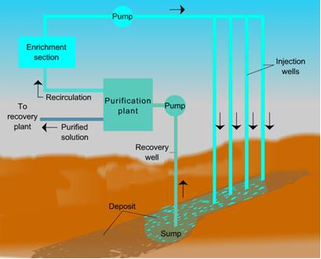
Underground leaching (in-situ leaching)
Underground leaching was originally used for mining of water dissoluble salts and sulphur. Nowadays, it is used especially to leach low-concentrated deposits of copper, uranium and gold. During this method, solutions of suitable agents are pumped into drill holes in the vicinities of ores deposits, in some cases to the depth of 1,500 m (Fig. 8.1). The solutions penetrate the rock along its cleavage and fracture planes and dissolve the mineral contained in the ore. The leachate is pumped to the surface at a suitable place and subsequently processed. Regenerated leaching agent is returned to the leaching process.

Slide 8
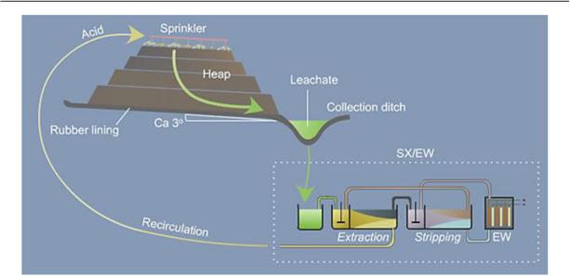
Heap leaching
A layer of ore in the height of 6 – 9 m is poured on a flat surface covered with asphalt or rubber.
Then the ore is sprayed from the top with water or a diluted solution of H2SO4, or a leaching solution is supplied into the layer using perforated pipes. Diameters of ore particles are approximately 25 mm.
Pregnant leach solutions (PLS) / Leachates are collected and further processed.
The method is applied to leach low-concentrated uranium, copper ores.

Slide 9
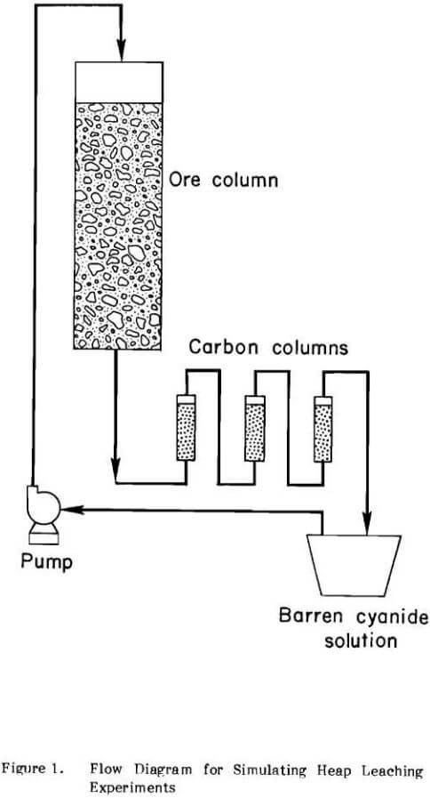
Percolation leaching
In percolation leaching, the leach solution is percolated upward or downward through an ore which has already been crushed and bedded into tanks.
Percolation leaching is usually used for ores with bigger lumpiness, pellets or agglomerates, which can easily be leached.
Usually, a mixture of coarse and fine ores is used so as to ensure permeability.
By subjecting the ore to 10 or more leach cycles, 80 to 90 per cen/t of the metal values can be recovered

Slide 10
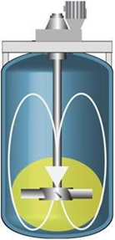
Agitation leaching
Leaching is significantly influenced by the proportion of liquid and solid phases.
To ensure maximum leaching efficiency, this ratio has to be the lowest possible. Other factors influencing the leaching process are material lumpiness, temperature, pressure and intensity of contact of ore particles with the leaching solution. Agitation leaching can be performed either continuously, or discontinuously (Fig. 8.5).
During continuous leaching, a mash flows through a line of agitation units connected one by one. This method is usually supplemented with continuous vanning, thickening and filtering.
During discontinuous leaching, a mash is pumped into simultaneously operating agitation units and then pumped out into a catch basin after leaching. This process is constantly repeated.
Leaching tanks with agitators are divided into these groups:
mechanical:
mash collecting tanks (reservoirs of mash kept in a suspended state),
tanks with propeller agitators,
tanks with suction agitators,
pneumatic
combined
Leaching tanks with agitators [5].

Slide 11
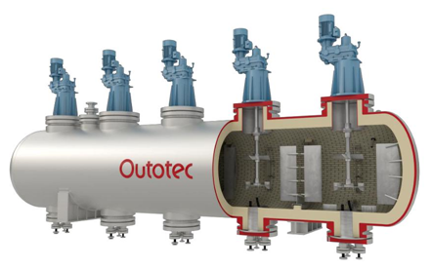
High-pressure leaching (autoclave leaching)
Application of increased pressure and temperature leads to acceleration of chemical reactions. Some reactions also begin to occur at these conditions. For example, ferrites of Zn or Cu are only hardly dissoluble in sulphuric acid under normal conditions. Nevertheless, if the leaching temperature increases to 160°C, they dissolve very easily. Leaching under high pressures is performed in specialized pressure vessels – autoclaves (Fig. 8.6) – which have to be resistant to high pressures (up to 10 MPa), to effects of various agents and to abrasion of transferred mashes. Dissolubilities of gasses multiply at increased pressures, which results in an occurrence of reactions between gasses and minerals, which would not occur (or only rarely) under normal pressure conditions.
Autoclave processes, running with a participation of oxygen, are processes during which:
Oxidation of metals or lower oxides to dissoluble forms occurs; for acidic leaching under pressure, the necessary sulphuric acid can be replaced by an addition of finely ground pyrite.
Oxidation of original elements, on which the produced metals are bound, occurs.
4 CoAsS + 13 O₂ + 6 H₂O=4 CoSO₄ + 4 H₃AsO₄
3) Oxidation of both the components occurs:
MoS₂ + 9 O₂ + 6H₂O=2 H₂MoO₄ + 4 H₂SO₄

Slide 12
Biological leaching
Biological (bacterial) leaching includes processes of ores leaching, during which microorganisms are used together with chemical agents to convert metals to solutions. Bacteria are generally wide-spread in soil, water and air. Depending on the materials necessary for their existence they can be denoted as:
a) heterotrophic
b) autotrophic
Heterotrophic bacteria use final organic compounds (carbohydrates, proteins etc.), while autotrophy bacteria need only inorganic substances for their existence. Bacteria applied during leaching belong to autotrophic bacteria:
1. Thio- bacteria, e.g. thiobacillus thiooxidans – have the ability to oxidize sulphur and sulphides to sulphuric acid.
2. Ferrobacillus – the source of energy is an oxidation reaction of divalent iron.
3. Thiobacillus ferrooxidans – have the properties of both the above mentioned groups.

Slide 13
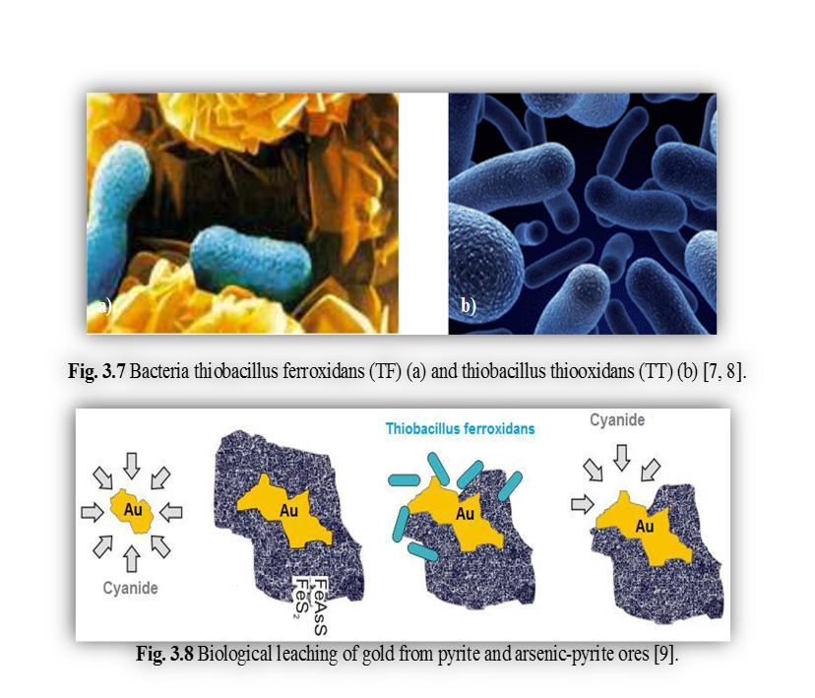
In hydrometallurgy of sulphides, the highest importance has the thiobacillus ferrooxidans (TF) and thiobacillus thiooxidans (TT) bacteria – Fig. 8.7.
Both types of these bacteria are suitable for hydrometallurgy, since they supplement each other. TF oxidizes pyrite to iron sulphate in a biochemical way and by this enables dissolution of other ores components in a chemical way (Fig. 8.8):
2 FeS₂ + 7 O₂ + 2 H₂O=2 FeSO₄ + 2 H₂SO₄
4 FeSO₄ + O₂ + 2 H₂SO₄=2 Fe₂(SO₄)₃ + 2 H₂O Fe₂(SO₄)₃ further chemically reacts:
Cu₂S + Fe₂(SO₄)₃=CuSO₄ + 2 FeSO₄ + CuS
The produced FeSO4 is biochemically re-oxidized and therefore can again contribute to leaching FeSO₄ + 12 O₂ + H₂SO₄ = Fe₂(SO₄)₃ + H₂O
Elemental sulphur, generated as the final product during leaching of sulphides, accumulates on the ores surfaces and inhibits further diffusion.
By this reason, the presence of TT bacteria oxidizing the generated sulphur to the sulphuric acid is necessary.
2S+3O₂+2H₂O=2H₂SO₄
Biological leaching enables processing of old dumps, as well as underground leaching of deposits, which are non-mineable by other methods due to their low metals contents. Its significant advantage is a high yield degree, often up to 96%.

Slide 14
Answer to the following questions:
Which factors do influence the selection of leachning reagents?
What is the principle and application of in-situ, heap leaching?
What is the principle and application of agitation and high pressure leaching?
What are the method used for leaching low-concentrated ores of U, Cu?
What bacteria is used in bioleaching? Explain the mechanism of bacterial leaching?
https://www.youtube.com/watch?v=xH7oZelswuE
https://www.youtube.com/watch?v=Oc1OYb5hHAc

