Slide 1
Metallurgical engineering
MET4331
3 credits
Ph.D, Assistant Professor Mamyrbayeva Kulzira Kaldybekovna

Slide 2
Lecture 11. Electrometallurgy_2
Today’s subtopics:
  Electrometallurgy. Unit Electrometallurgical Processes
  Electrowinning
  Electrosmelting
  Electroforming
  Electroplating

Slide 3
Electrometallurgy
Electrometallurgy includes all metallurgical proceses which utilize electoricity and electrical effects.
Electrometallurgy is the field concerned with the processes of metal electrodeposition.
Main groups of the electrometallurgical processes are:
Electrowinning, the extraction of metal from ores.
Electrorefining, the purification of metals.
Electroplating, the deposition of a layer of one metal on another.
Electroforming, the manufacture of, usually thin, metal parts through electroplating.

Slide 4
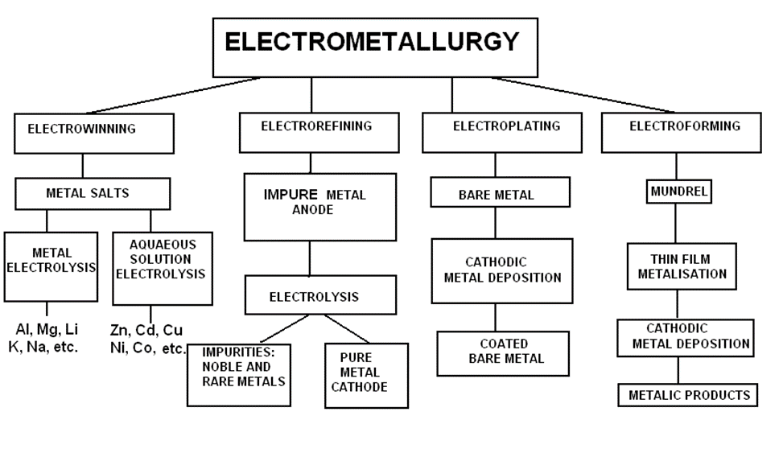
Types of electrometallurgical processes

Slide 5
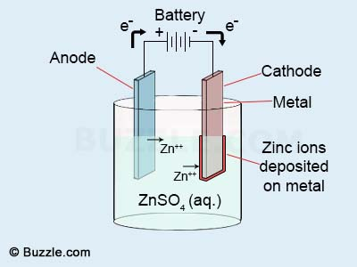
Electrowinning_Electrolysis from an aqueous solution
Electrowinning is the extraction of metals by electrodeposition from aqueous solution or melts of their salts. On a large-scale electrodeposition from molten salts is used for extraction of electronegative elements which cannot be electrodeposited from aqueous solutions, such as aluminum and magnesium, as well as very pure copper, zinc and cadmium by electrodeposition from an aqueous solutions of the metal salts.
Example Electrolysis from an aqueous solution is applied for example to separate Zn from a H₂SO₄ solution.
The electrolyte has to be well refined from admixtures before the electrolysis, since Zn is more electronegative than other admixture elements. As electrodes, dissoluble lead anodes and aluminum cathodes are mostly used.
The process can be described by the equation:
ZnSO₄ + H₂O = Zn + H₂SO₄ + ½ O₂
Zn is generated on the cathode and sulphuric acid is regenerated on the anode due to a generation of oxygen.
Therefore, the following can separate on the cathode from a well refined solution:
Zn²⁺ + 2 e = Zn
2 H⁺ + 2 e = H₂
Hydrogen should be generated primarily. The reactions occurring on the anode:
2 OH⁻ - 2e = H₂O + ½ O₂ Pb – 2e = Pb²⁺
The first reaction is the main one, the second occurs only for new anodes and ceases quickly as a result of generation of PbO2 on the surface of the anode. The quality of the anode increases with the addition of 1% Ag. If admixtures, such as Cu, Cd, Sb, Pb or Fe are present in the electrolyte, they generate on the cathode before zinc. Cobalt and nickel cause corrosion of the generated Zn and decrease current efficiency.

Slide 6
Electrorefining
In electrorefining, the crude metal is electrolytically dissolved at the anode and deposited
as pure metal at the cathode according to the reactions:
M(impure)= M ^{n+}+ ne (at the anode )
M ^{n+}+ ne = M (pure) at the cathode
The overall reaction is:
M (impure) = M (pure)
Adoption of this process requires fulfilling the following criteria:
1. Ionic species in the electrolyte should support an anodic reaction.
2. Ionic species in the electrolyte should get reduced at the cathode.
3. The electrolyte should be capable of ionic transport.
4. A metallic conductor is required for transporting the electrons through the external
circuit from the anodic to cathodic site.

Slide 7
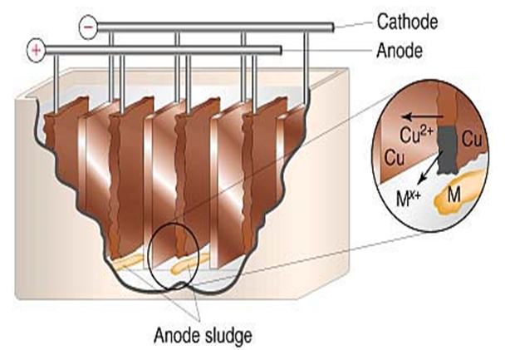


Electrorefining of Copper
A typical example of application of this type of electrolysis is refining of copper.
Copper is widely used to make electrical wiring and in other applications that utilize its high electrical conductivity.
Crude copper, which is usually obtained by pyrometallurgical methods, is not suitable to serve in electrical applications because impurities greatly reduce the metal's conductivity.
The electrolyte consists of an acidic solution of CuSO₄. The anode consists of a copper refined by fluxing, the cathode is a thin sheet of electrolytic copper.
Application of a suitable voltage to the electrodes causes oxidation of copper metal at the anode and reduction of Cu²⁺ to form copper metal at the cathode.
After connection of direct current, copper dissolves from the anode:
Cu – 2e = Cu²⁺
This strategy can be used because copper is both oxidized and reduced more readily than water.
The relative ease of reduction of Cu²⁺ and H₂O is seen by comparing their standard reduction potentials:
Electrolysis cell for refining of copper. As the anodes dissolve away, the cathodes on which the pure metal is deposited grow in size.
2H₂O + 2e = H₂+ 2OH⁻ $E_{red}^{0}$=-0,83 V

Slide 8
The impurities in the copper anode include lead, zinc, nickel, arsenic, selenium, tellurium, and several precious metals including gold and silver.
Metallic impurities that are more active than copper are readily oxidized at the anode but do not plate out at the cathode because their reduction potentials are more negative than that for Cu²⁺
However, less active metals are not oxidized at the anode. Instead, they collect below the anode as a sludge that is collected and processed to recover the valuable metals.
Depending on their electrochemical properties, impurities(admixtures) in anode copper can be divided into four groups:
More electropositive – do not form ions, form sediments at the bottom of an electrolytic cell, e.g. Au, Ag, Pt.
More electronegative – convert to solutions, they get to the cathode by stripping of electrolyte, e.g. Zn, Ni, Fe etc.
Elements with a standard potential close to the standard potential of copper – content of these elements (especially As, Sb, Bi) has to be maximally decreased before electrolysis in order to prevent their separation on the cathode.
Electrochemically neutral impurities – convert to anode sediments, e.g. Cu₂O, Cu₂S, Cu₂Se, Cu₂Te.

Slide 9
Electrolysis from molten-salts
Production of some metals by electrolysis of aqueous solutions, such as aluminum, is practically impossible due to their high electronegativities.
Another reason is that these metals form stable oxides and it is impossible to keep them in the form of free ions in environments of aqueous electrolytes.
In such cases, electrolysis of smelted salts is applied. Basic characteristics of the process:
losses of voltages on current supplies lead to higher effective voltage and electric energy consumptions
electrolytes are poly-component systems with high melting temperatures
if the melting temperature of a metal is lower than the melting temperature of the electrolyte, the metal separates in the form of crystals
if the melting temperature of a metal is higher than the melting temperature of the electrolyte, dissolution of the metal in the electrolyte in the form of smelt can occur, which leads to metal losses and a higher electric energy consumption
anode effect

Slide 10
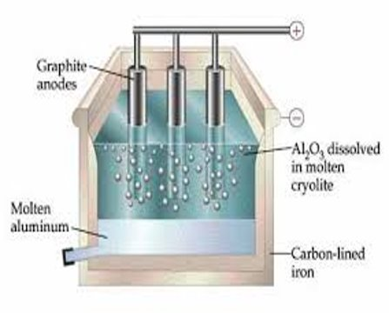
Example:
Production of Al, for which the electrolyte consists of Na₃AlF₆ + Al₂O₃ + (CaF₂).
The anode is formed from a graphite block, the cathode consists of a steel bath with graphite lining – the produced metal generates there.
Reaction on the anode:
2AlO ³⁻ - 6e- = Al O + 3/2O
Al³⁺ +3e- = Al
Fig. 11.3 - Electrolyses of Al

Slide 11
Electroplating can be defined as a treatment that modifies the surface of a metal or occasionally a nonmetal, without changing its bulk properties, in order to improve the appearance of a surface, to increase the corrosion and abrasion resistivity, etc. Electroplating can be performed from molten salts and aqueous and non-aquaeous solutions, depending on the nature of electrodeposited metal, but most frequently from aqueous solutions’
Types of Electroplating
There are different processes by which people can electroplate metals such as by mass plating (also barrel plating), rack plating, continuous plating, and line plating. Each process has its own set of procedures which allow for the ideal plating
The half-reactions in electroplating a fork, for example, with silver are as follows:
cathode (fork): Ag+(aq)+e−→Ag(s) E°cathode=0.80V(15)
anode (silver bar): Ag(s)→Ag+(aq) E°anode=0.80V(16)
The overall reaction is the transfer of silver metal from one electrode (a silver bar acting as the anode) to another (a fork acting as the cathode). Because E°cell = 0 V, it takes only a small applied voltage to drive the electroplating process. In practice, various other substances may be added to the plating solution to control its electrical conductivity and regulate the concentration of free metal ions, thus ensuring a smooth, even coating.
Electroforming is an electrodeposition process that can be concluded in a series of steps including Cleaning, Coating, Exposing, Developing, Deposition, and Harvesting. If deposit is good from electroplating point of view except adhesion and can be removed from the cathode as an entity in itself, it has been electroformed.

Slide 12
Configurations of industrial cells and cell lines
An industrial electrolytic operation can be discontinuous, continuous or semicontinuous.
If it is discontinuous, the tank is filled with an electrolytic solution of a given composition, which progressively looses the ions of the metal to be deposited. The operation consists of allowing the deposition at the cathode to proceed for a given time, then extracting the cathodes to recover the metal deposited by removing the deposit of the cathode if it is made of a different metal.
The operation can be semicontinuous, i.e. with a continuous flow of electrolyte through the cell. The variation of the electrolyte composition between the inflow and outflow is kept small by adjusting the electrolyte flow rate. Electrolysis proceeds then until the cathode reaches a desired weight. The cathodes are extracted in order to recover the metal deposited. Aqueous electrolysis of Cu, Ni and Zn salts operate in this way.
The operation can be continuous, as for alumina electrolysis, where the alumina powder is fed continuously and the liquid metal is extracted continuously .
A large variety of configurations of electrowinning cells exist. They can be divided into two main categories: rectangular cells, which are the most commonly used industrially, and cells with cylindrical concentric electrodes.
In the cells made of a couple of concentric tubes (an internal anode and an external cathode), a high electrolyte flowrate between the tubes can be achieved that minimizes the thickness of the diffusion layers. Very dilute solutions can be electrolyzed [WAN 02].
The rectangular electrodes are piled up in a cell tank, known as a cell. Two main types of cells can be found: cells with monopolar electrodes (a) and cells with bipolar electrodes (b), see Figure 11.4.
Basic monopolar and bipolar cells and cell stack configurations
Monopolar electrodes connected in parallel in a cell tank;
bipolar electrodes connected in series in a battery;
a' and b') bus connections of cell stacks f, where
a') is a row of monopolar cells in
series and
b') bipolar parallel cell stacks

Slide 13
  Selection of a proper electrolyte
In electrolytic operations, the selection of a proper electrolyte is the most important requirement. The basic conditions that an electrolyte must satisfy are:
1. it must have a sufficiently high ionic conductivity, and conduction must be entirely due ions.
2. it must be chemically inert towards the electrodes, the container material, and the electrolysis products.
3. it must be stable at the temperature of operation.
4. when a solution containing the metal to be extracted is being used, then it must be chemically more stable than the solute.
Common metals such as Cu, Zn, Sn, Au, and Mn can be produced by aqueous electrolysis, whereas reactive metals such as Ti, Zr, Th, Na, K, Mg, and Al cannot. To obtain reactive metals, their fused salts must be electrolyzed at a high temperature.

Slide 14
Answer to the following questions:
What is electrowinning?
Which non-ferrous metals are obtained by electrolysis of aqueous solutions?
Which non-ferrous metals are obtained by electrolysis of melts?
What are the basic characteristics of fused salt electrolysis?
What is the application of Electroplating and Electroforming?
Selection of a proper electrolyte

