Slide 1
Metallurgical engineering
MET4331
3 credits
Ph.D, Assistant Professor Mamyrbayeva Kulzira Kaldybekovna

Slide 2
Lecture 12-1
Corrosion. Causes of Corrosion
Learning objectives:
What is Corrosion?
Classification of Corrosion
Corrosion system
Corrosion Phenomena
Atmospheric, electrochemical Corrosion

Slide 3
All materials or products, plants, constructions, and buildings made of such materials are subject to physical wear during use.
The interaction with certain media of the environment results in undesired reactions of the materials that trigger corrosion, weathering, decaying, embrittlement, and fouling.
While mechanical reactions lead to wear, chemical and electrochemical reactions cause corrosion.
Corrosion is deﬁned as:
Corrosion is the gradual destruction of materials, (usually metals), by chemical reaction with its environment.

Slide 4
Corrosion system: A system consisting of one or several metals and such parts of the environment that affect corrosion.
When unalloyed or alloyed steel without corrosion protection is exposed to the atmosphere, the surface will take on a reddish-brown color after a short time. This reddish-brown color indicates rust is forming and the steel is corroding.
In a simpliﬁed way, the corrosion process of steel progresses and is chemically based on the following equation:
Fe+SO₂ + O₂ = FeSO₄ (1)
4Fe + 2 H₂O + 3O₂ =4FeOOH (2)

Slide 5
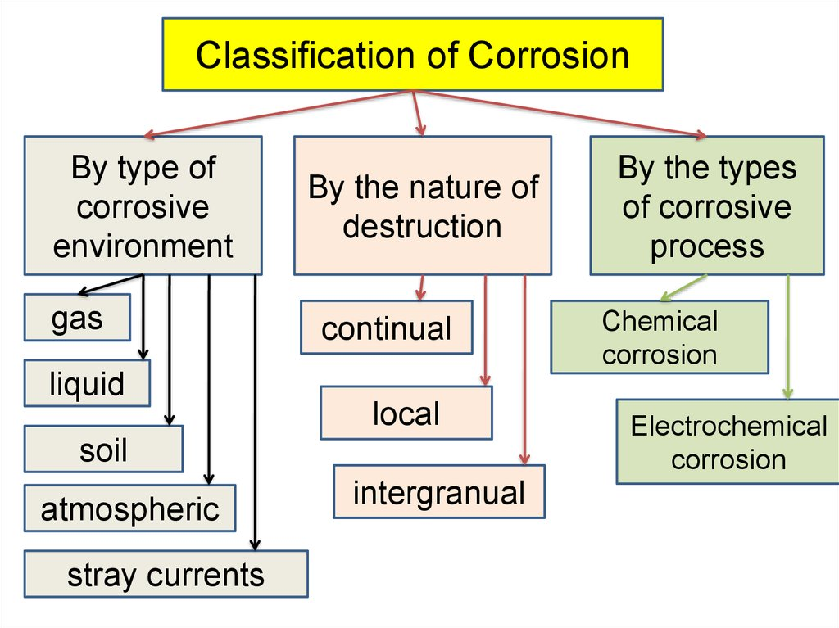
Corrosion classification
Corrosion occurs in several widely different forms.
Classification is usually based on one of the three factors:
Nature of the corroding: corrosion can be classified as wet or dry.
A LIQUID / MOISTIRE is necessary for wet corrosion while dry corrosion usually involves the reaction with high temperature gases
Appearance of the corroded metal: Corrosion is either uniform: here the metal corrodes at the same rate over the entire surface or it is localised in which case only small areas are affected and intergranular.
Mechanism of corrosion : this involves either electrochemical or direct chemical reactions

Slide 6
The corrosion processes begins when a corrosive medium acts on a material. Since (energy-rich) base metals recovered from naturally occurring (low-energy) ores by means of metallurgical processes tend to transform to their original form, chemical and electrochemical reactions occur on the material’s surface.
Two kinds of corrosion reactions are distinguished:
  chemical corrosion
Corrosion excluding electrochemical reaction,
  electrochemical corrosion
Corrosion including at least one anodic and one cathodic reaction.

Slide 7
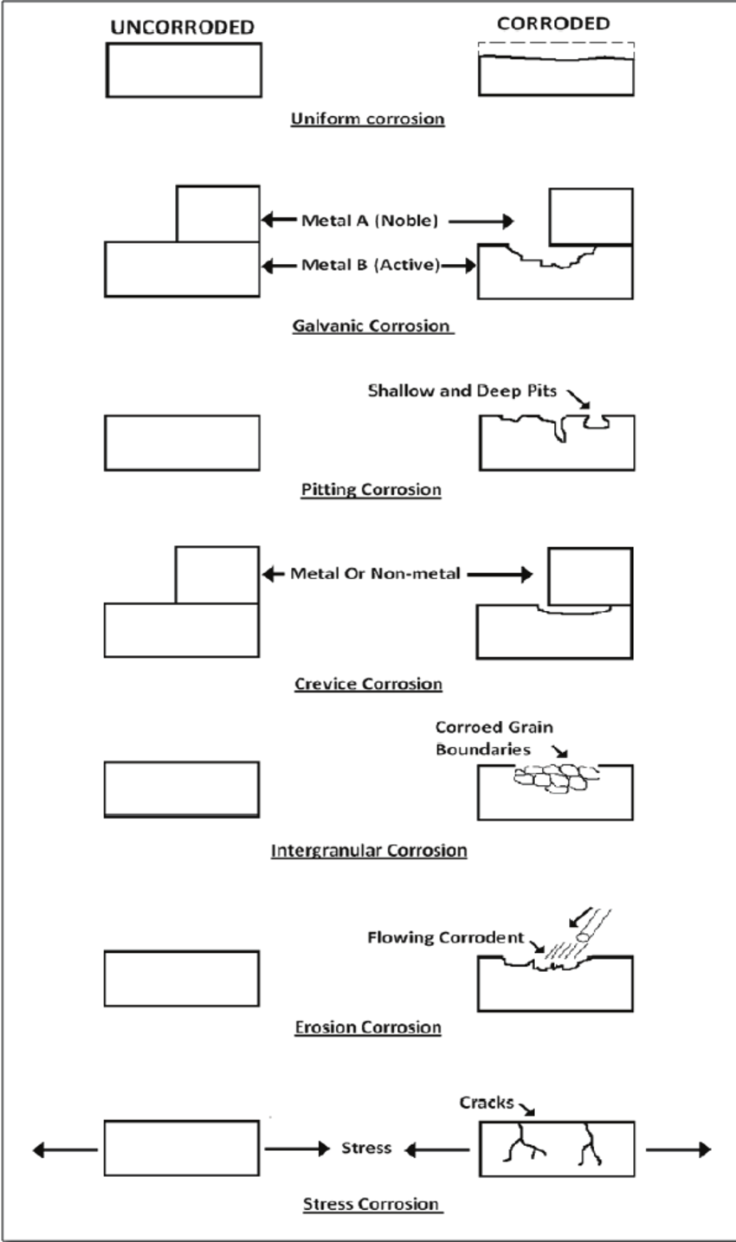
Types of Corrosion
Corrosion does not only occur as linear abrasion, but in versatile forms of appearance. Important variants for unalloyed or alloyed steel are:
Uniform surface corrosion
General corrosion occurring on the entire surface at nearly the same rate.
Shallow pit corrosion
Corrosion with locally different abrasion rates; caused by the existence of corrosion elements.
Pitting corrosion
Local corrosion resulting in holes, that is, in cavities expanding from the surface to the inside of the metal.
Crevice corrosion
Local corrosion in connection with crevices occurring in or immediately adjacent to the crevice area, which has developed between the metal surface and another surface (metal or nonmetal).
Contact corrosion (aka dissimilar metal corrosion)
Occurs at contact surfaces of different metals; the acceleratedly corroding metal area is the anode of the corrosion element.
Intergranular corrosion
Corrosion in or adjacent to the grain boundaries of a metal.
The standard mentioned above describes altogether 37 types of corrosion. These types of corrosion result in corrosion phenomena.

Slide 8
Corrosion Phenomena
Major corrosion phenomena are:
Uniform surface attack
A form of corrosion where the metal material is almost uniformly removed from the surface. This form is also the basis for the calculation of the mass loss (g/m²) or the determination of the corrosion rate (μm/ y).
Shallow pit formation
A form of corrosion with irregular surface attack forming pits with diameters much larger than their depth.
Pitting
A form of corrosion with crater-shaped or surface-excavating pits or pits resembling pin pricks. The depth of the pitting spots usually exceeds their diameter.
It is very difﬁcult to differentiate between shallow pit formation and pitting.

Slide 9
Atmospheric Corrosion
The corrosion rate in the atmosphere is insigniﬁcant as long as the relative humidity on the steel surface does not exceed 60%. The corrosion rate increases, especially
with inadequate ventilation,
With increasing relative humidity.
With condensate occurring (surface temperature < dew point).
In the presence of precipitation.
With increasing pollution of the atmosphere which may affect the steel surface and/or be deposited on it. Pollutants are gases, including sulfur dioxide, salts, chlorides, and sulfates. In connection with humidity, deposits like soot, dusts, salts, etc., on steel surfaces accelerate corrosion.
Temperature also, inﬂuences the corrosion process.

Slide 10
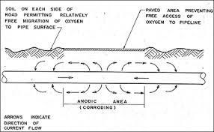
Corrosion in the Soil
The corrosion behavior is determined by soil conditions and electrochemical parameters, such as element formation with other component parts and the inﬂuence of alternating and direct current.
Special Corrosive Stress
Corrosive stress at the location, in the application area or through production- related inﬂuences is a special load that has a decisive impact on corrosion. Mainly, chemical stress is concerned, like operation-related emissions (acids, alkaline solu- tions, salts, organic solvents, aggressive gases, and dusts and others). However, special stresses may also be mechanical stress, temperature stress and combined stresses – contemporaneous presence of mechanical and chemical stress, and all enhance corrosion.

Slide 11
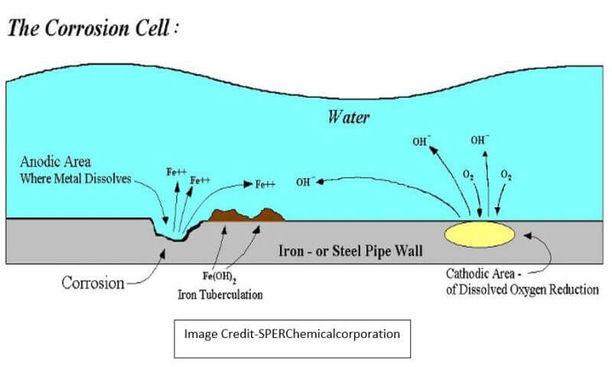
Corrosion in Water
Major conditions for corrosive stress in water are:
• the composition of the waters, such as oxygen content, kind and amount of dissolved substances in fresh water, brackish water and salt water;
• mechanical stress;
• electrochemical factors.

Slide 12
Electrochemical Corrosion
The special characteristic of most corrosion processes is that the oxidation and reduction steps occur at separate locations on the metal.
This is possible because metals are conductive, so the electrons can flow through the metal from the anodic to the cathodic regions.
The presence of water is necessary in order to transport ions to and from the metal, but a thin film of adsorbed moisture can be sufficient.
A corrosion system can be regarded as a short-circuited electrochemical cell in which the anodic process is something like
Fe(s)→Fe²⁺(aq) +2e–
and the cathodic steps can be any of O₂+2H₂O+4e– →4OH–
H+ + e– → ½ H₂(g)
Me ₂⁺ + 2e– →Me (s) where Me is a metal.

Slide 13
Answer to the following questions:
What is Corrosion?
Classification of Corrosion processes
What is Corrosion system?
Under what conditions does the rate of atmospheric corrosion increase?
Under what conditions does the rate of soil corrosion increase ?
What are the special characteristic of corrosion in water?
Explain the Electrochemical corrosion

